Slide 1
LADM
Version December, 24th 2021

Slide 2
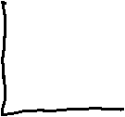






Slide 3
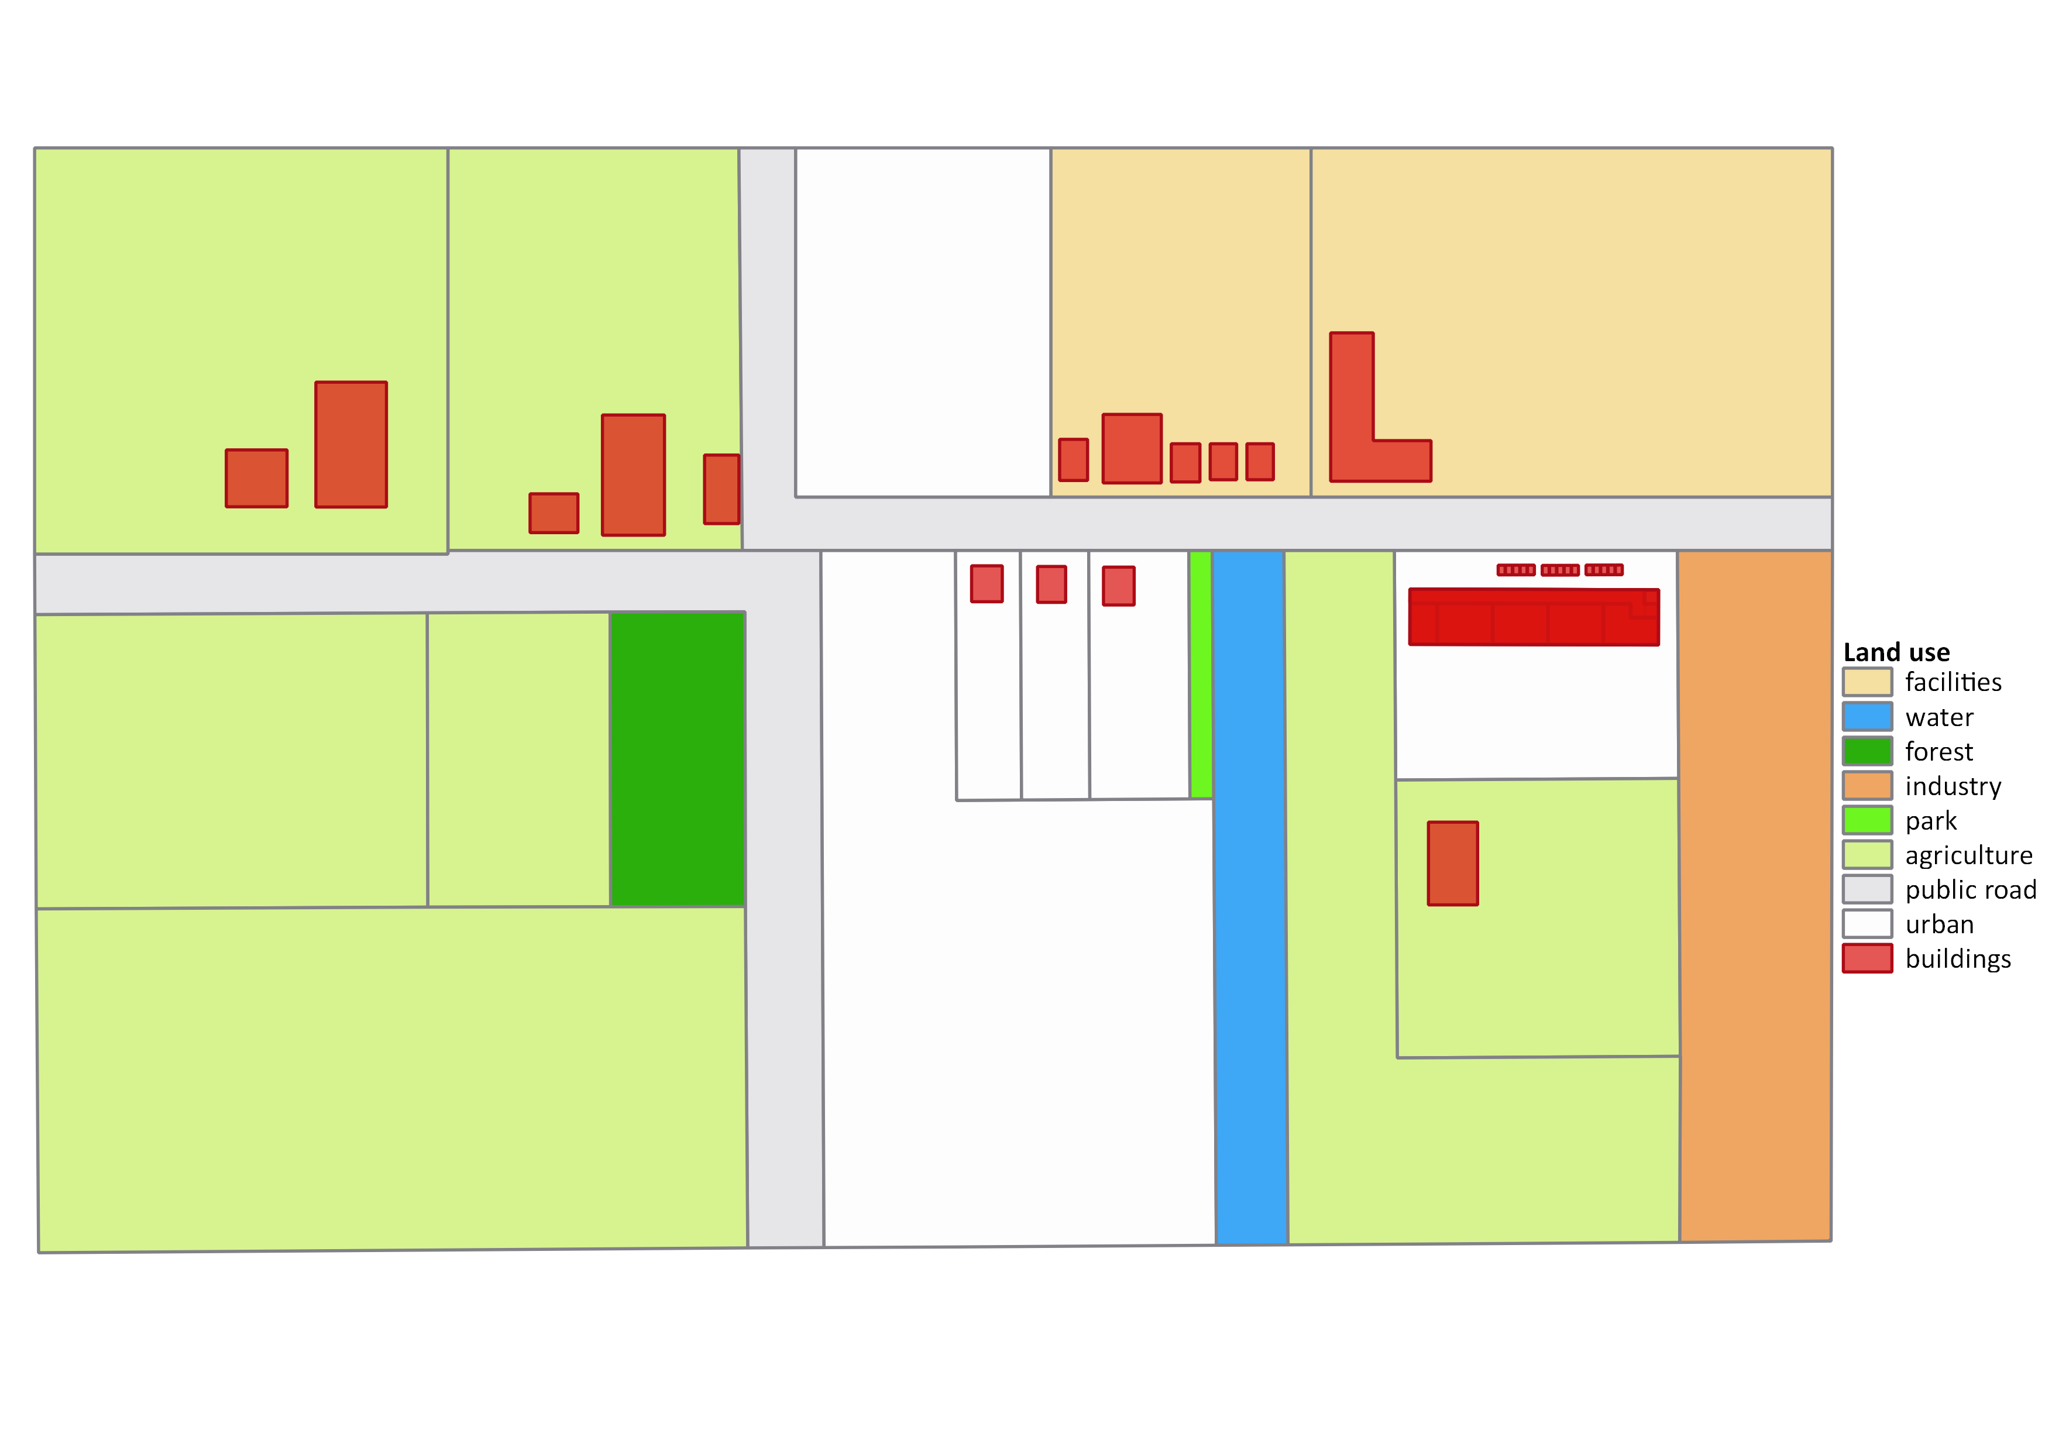
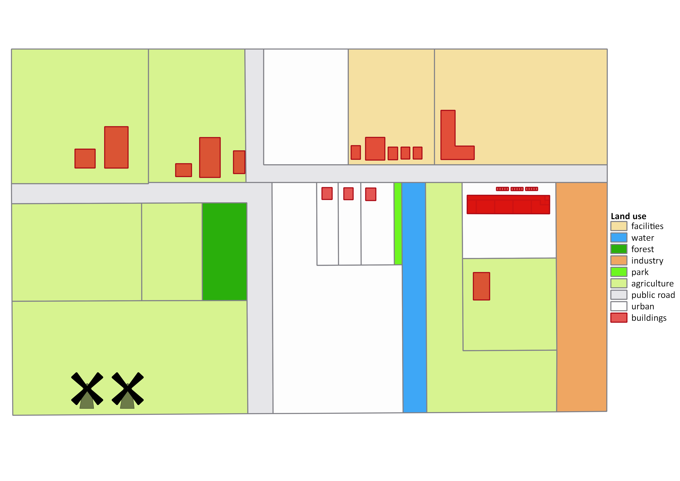

Welcome to the Municipality Waterriver

Slide 4
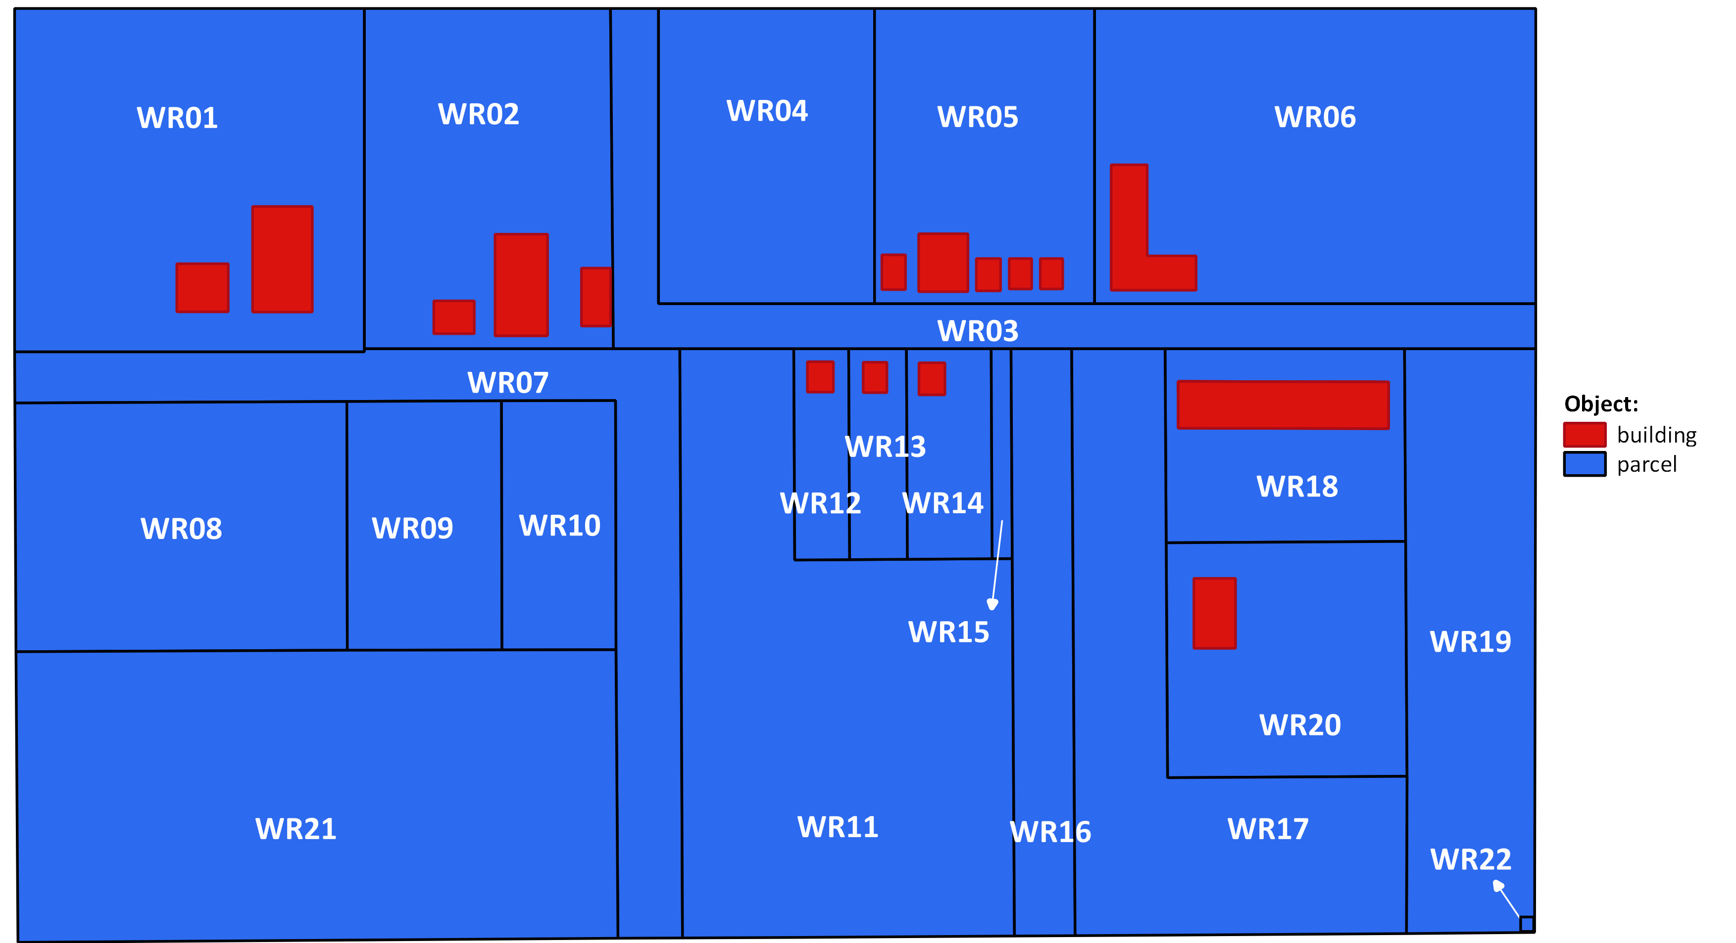
Cadastral Map Municipality Waterriver

Slide 5
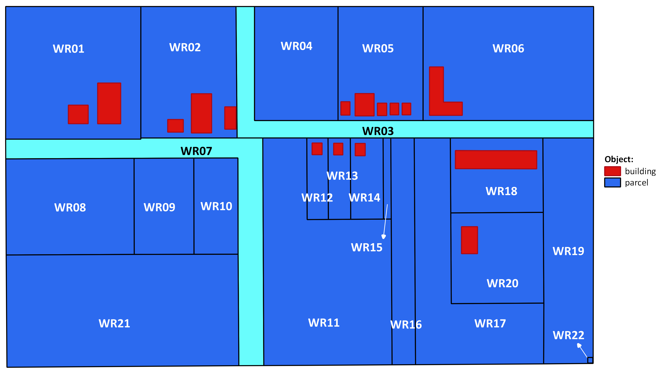
Public Roads

Slide 6
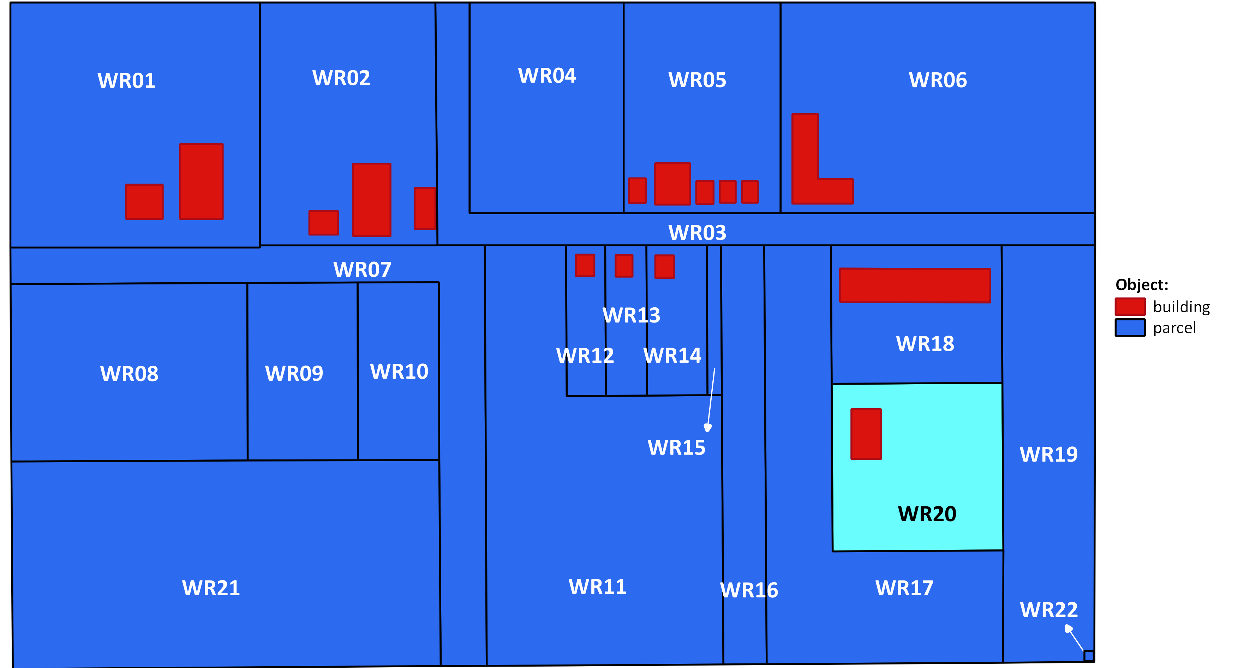
WR20 has no access to a public road

Slide 7
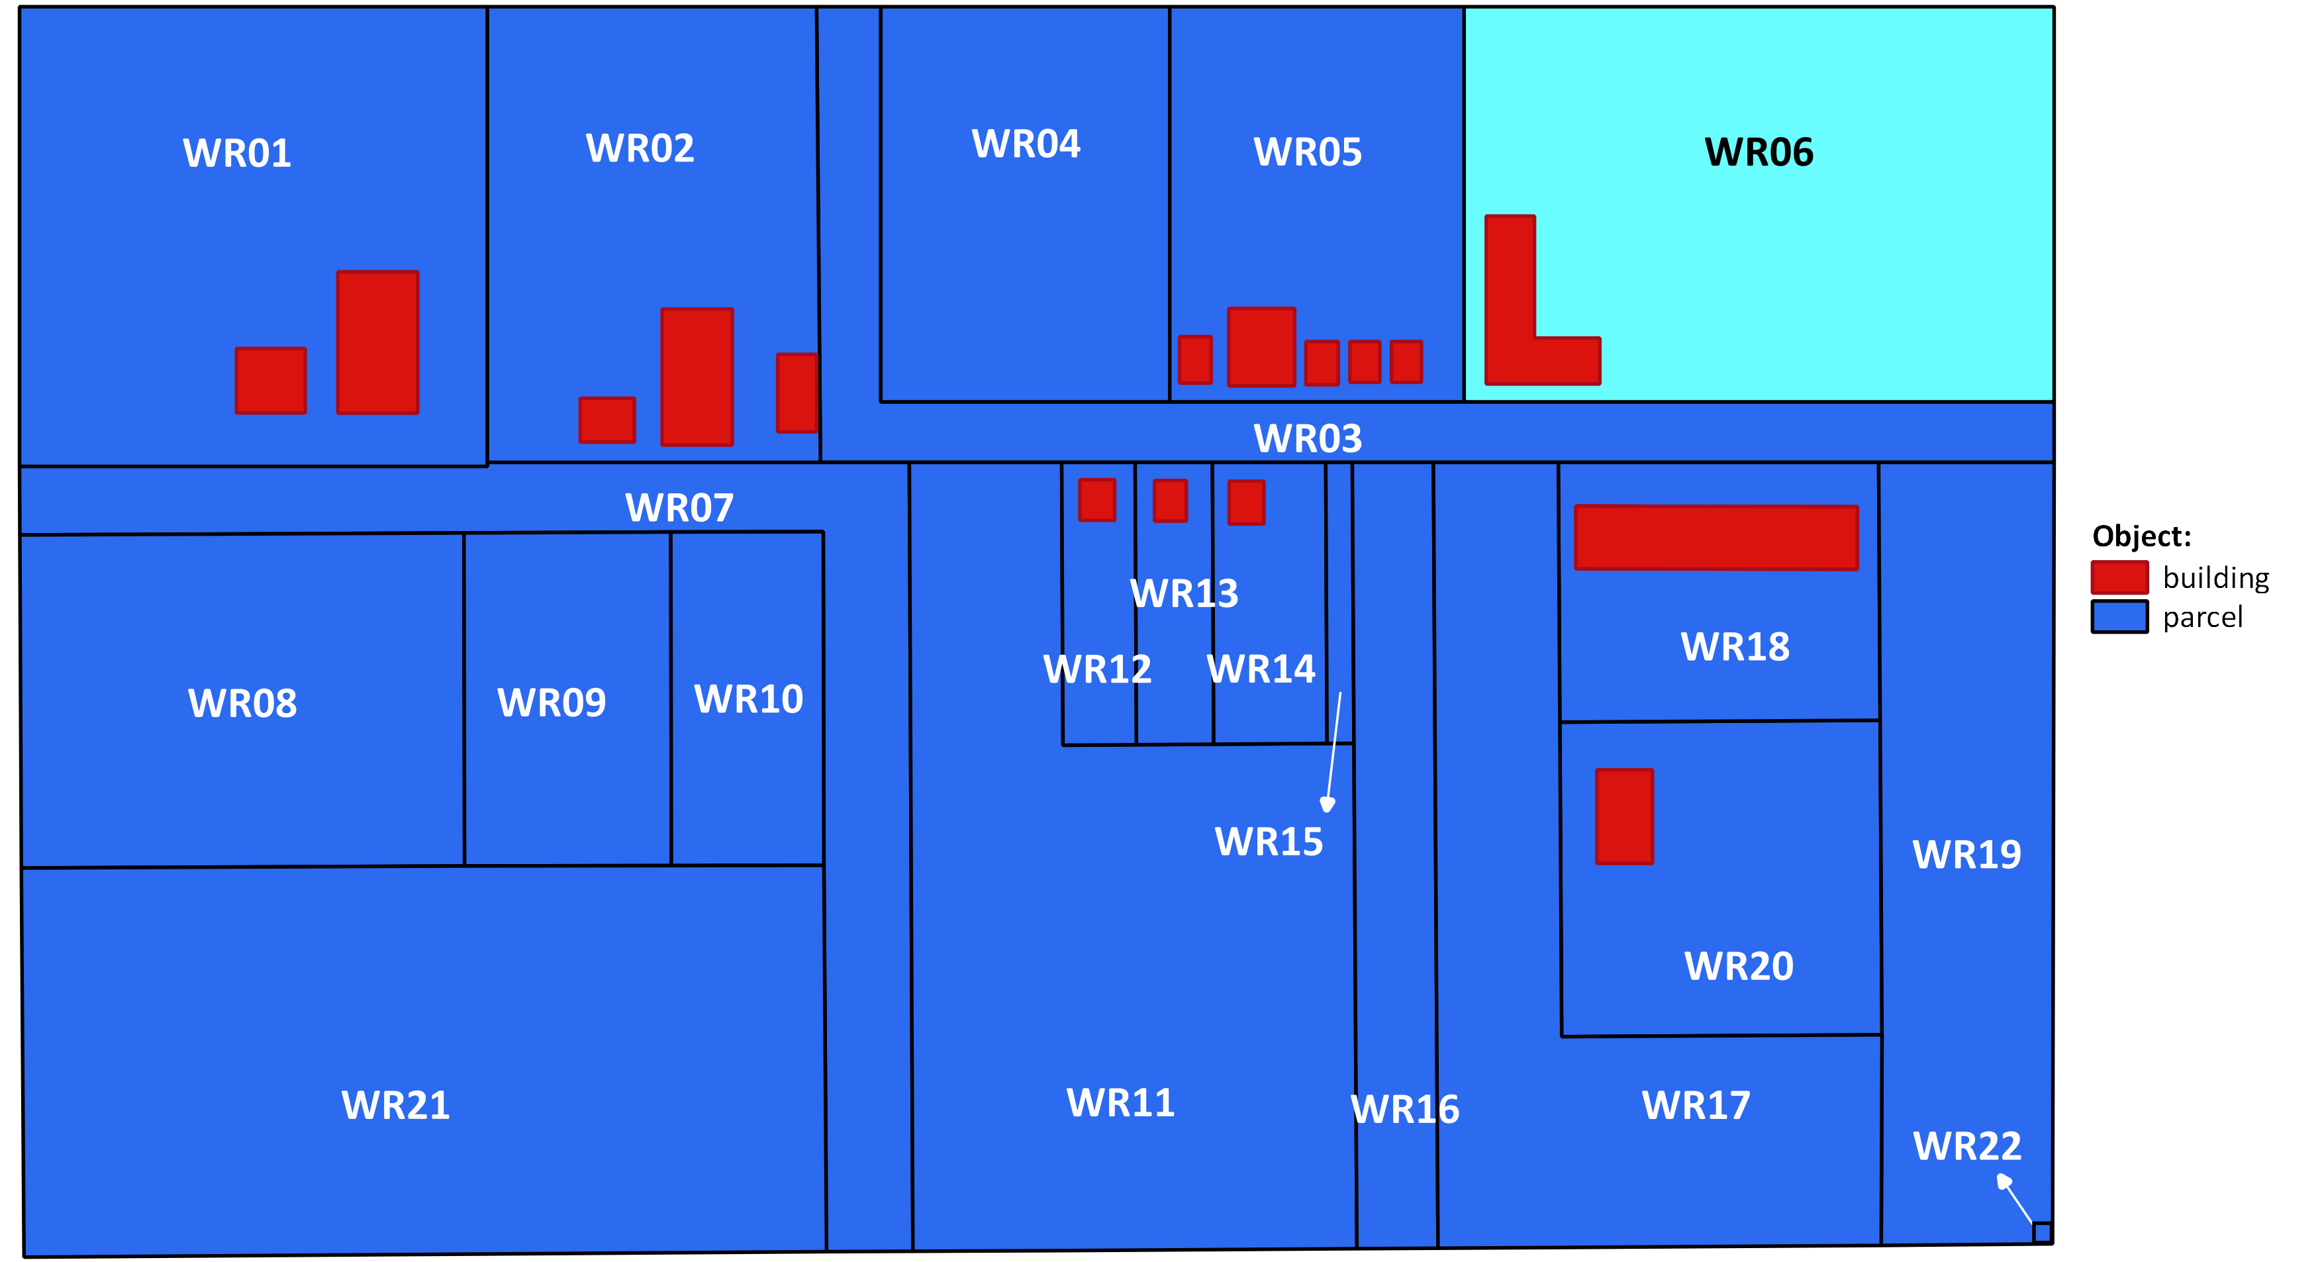
School

Slide 8
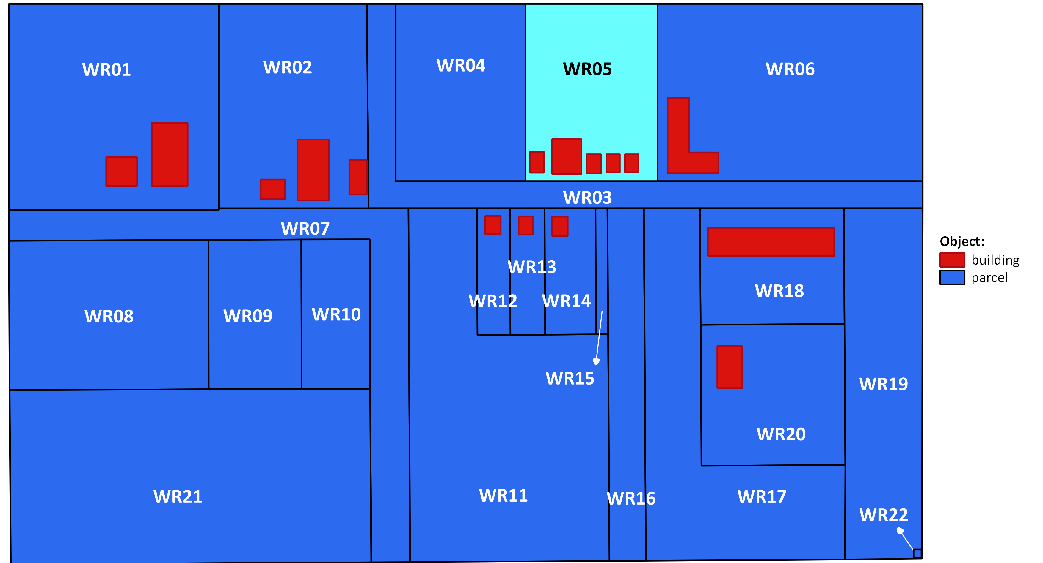
Municipal Offices and Services

Slide 9

Apartment

Slide 10
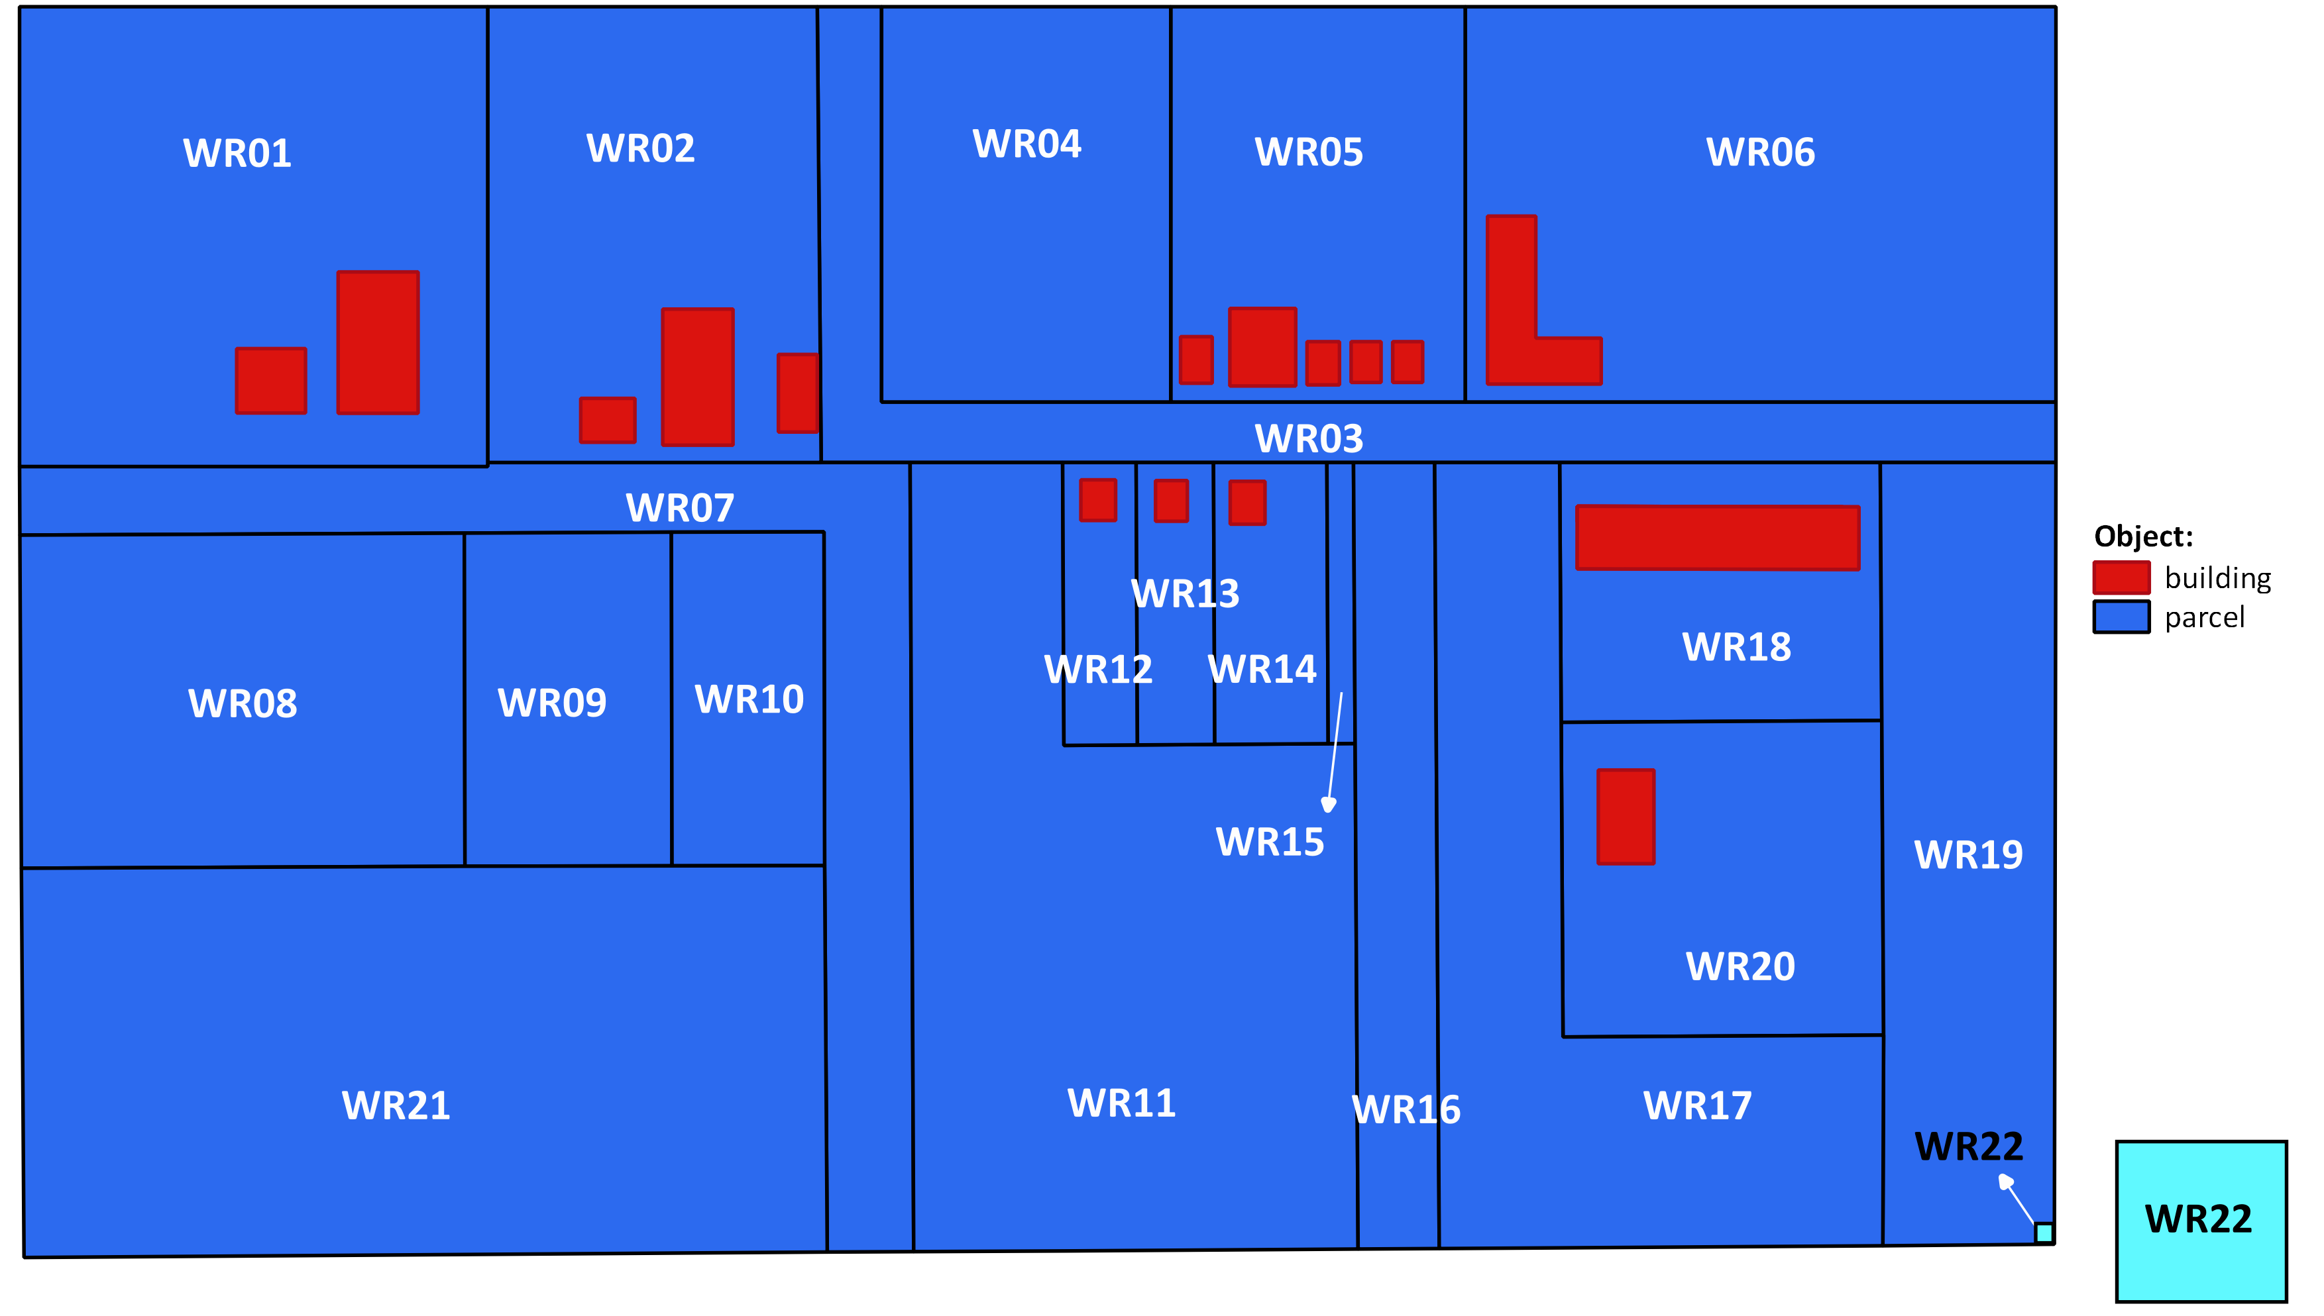
WR22 is 1 sqm – electrical power distribution

Slide 11
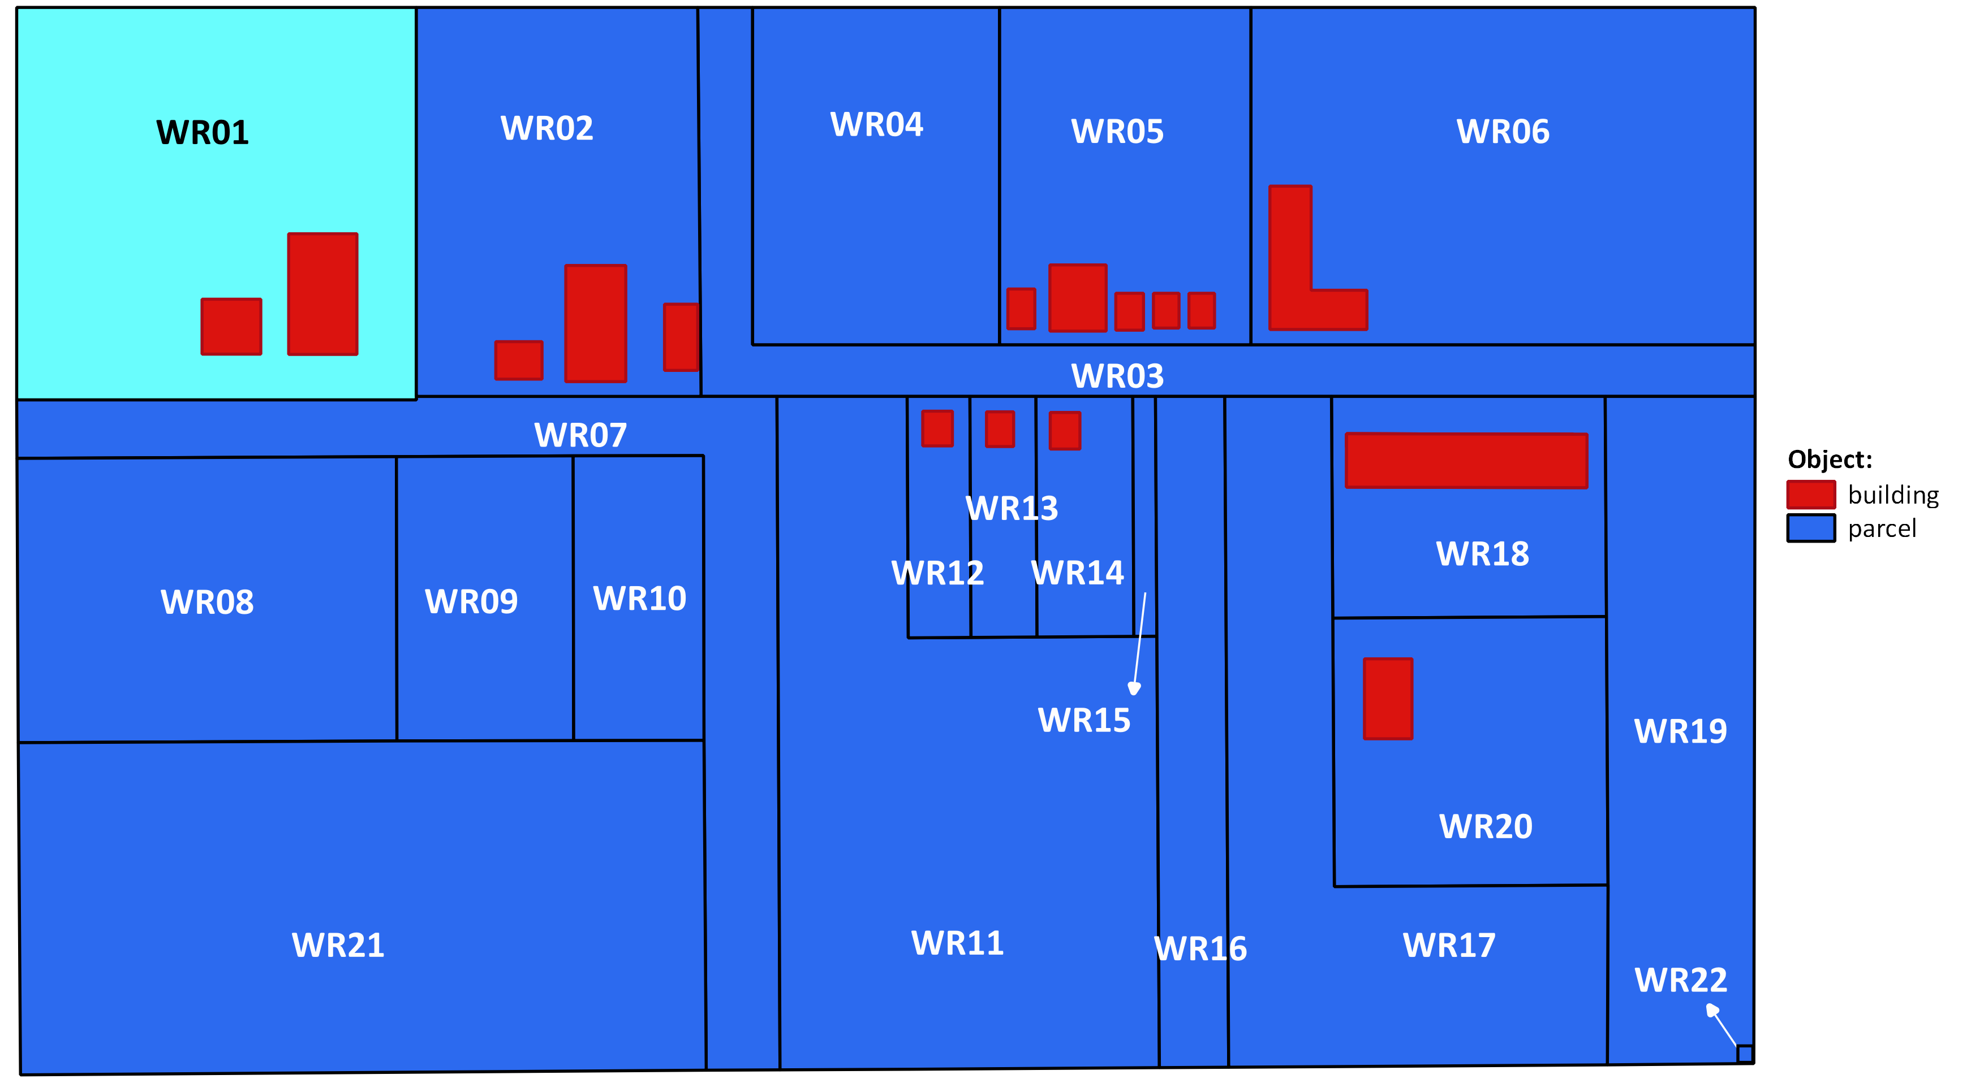
Carlos owns WR01
Ownership
Carlos

Slide 12
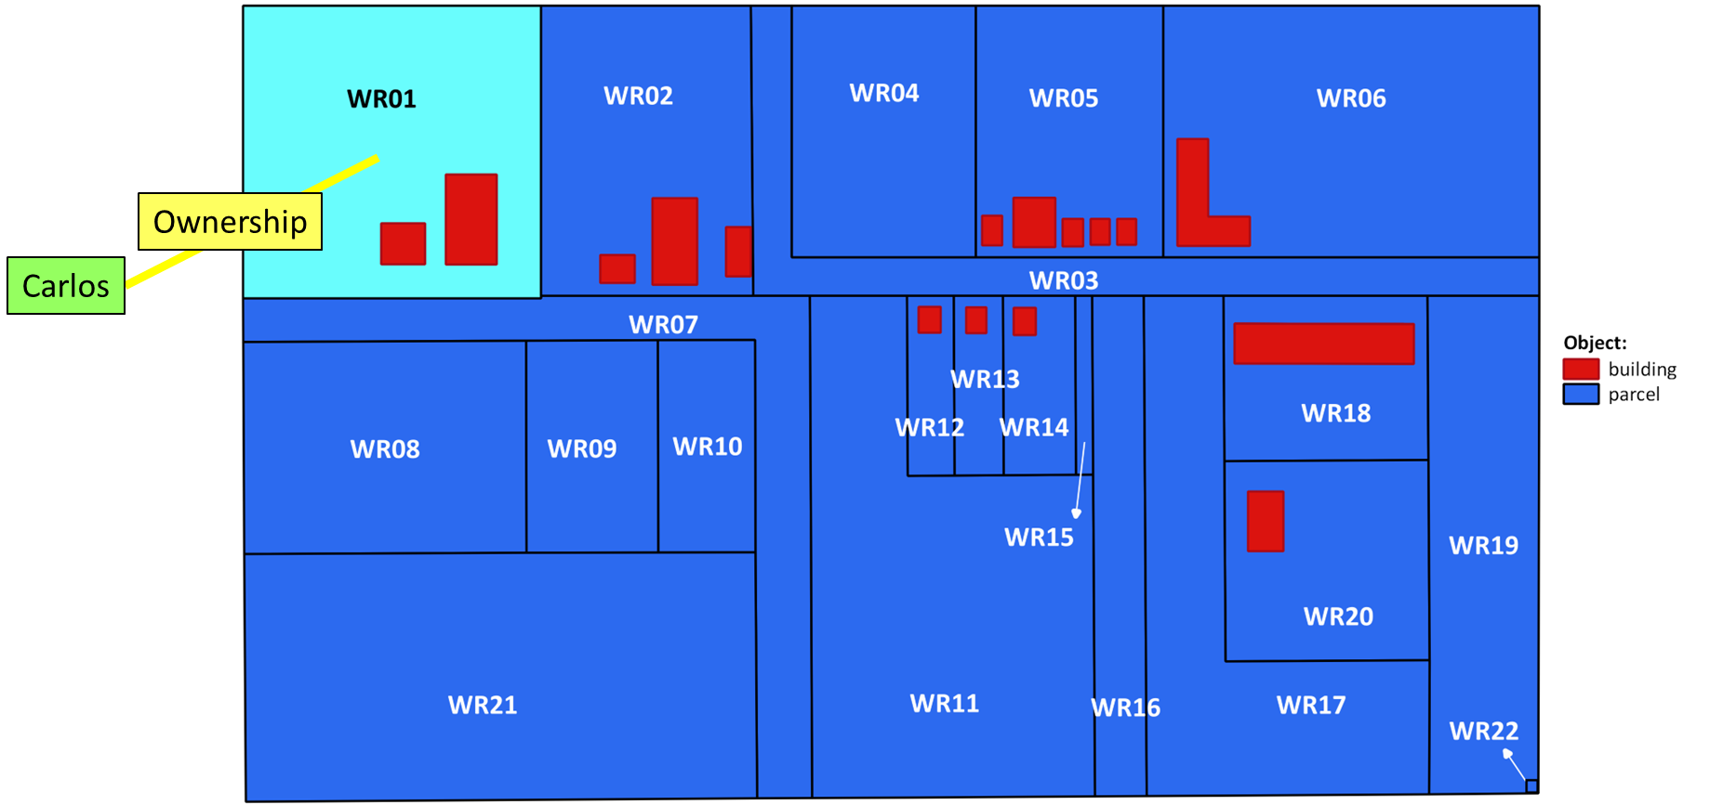
Carlos
Carlos P01
Ownership Right01
BAU01
WR01

Slide 13
BAU01?
?
Carlos P01
Ownership Right01
BAU01
WR01

Slide 14
p_id |  | name
1 | P01 | Carlos
2
3
4
5
6
7
8
9
10
11
12
13
14
15
16
17
18
r_id |  | type | share
1 | Right01 | Ownership
2
3
4
5
6
7
8
9
10
11
12
13
14
15
16
17
18
bau_id
1 | BAU01
2
3
4
5
6
7
8
9
10
11
12
13
14
15
16
17
18
su_id |  | area | geom | …
1 | WR01
2
3
4
5
6
7
8
9
10
11
12
13
14
15
16
17
18

Slide 15
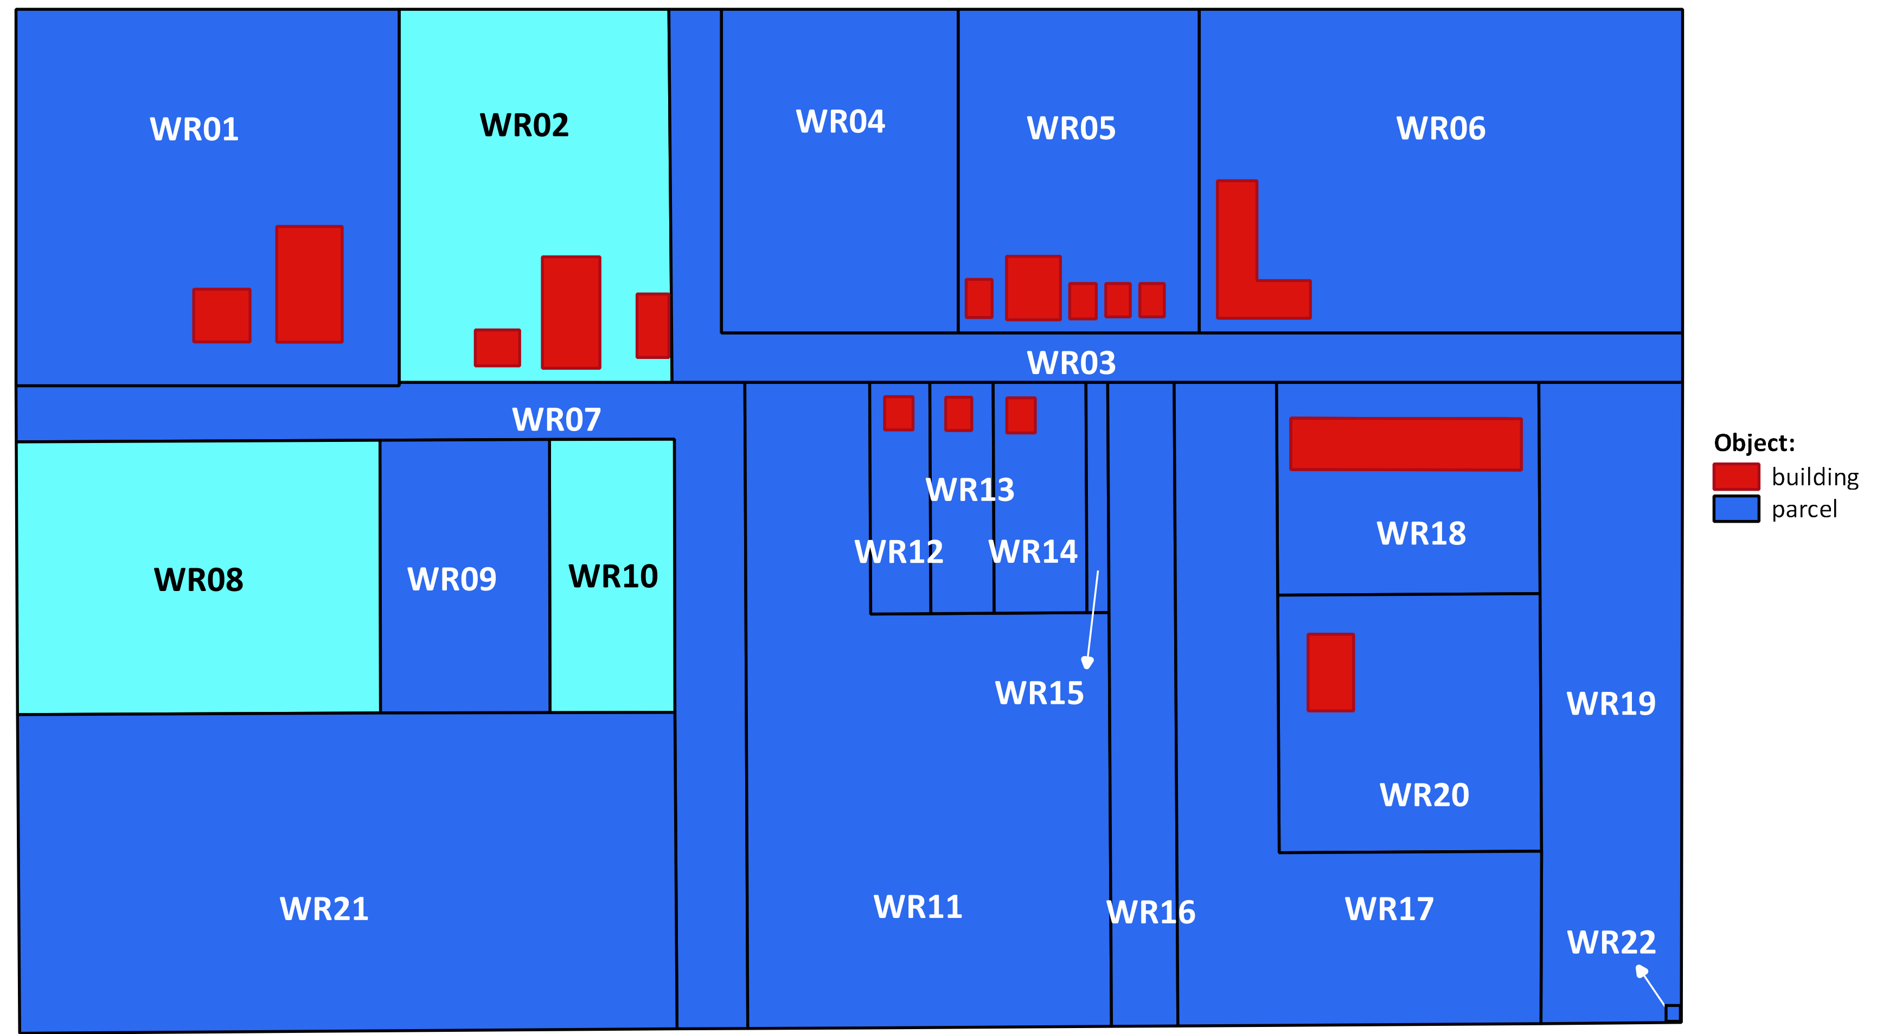
Elisabeth and Thomas own WR02, WR08 and WR10
Thomas
Ownership
Elisabeth

Slide 16
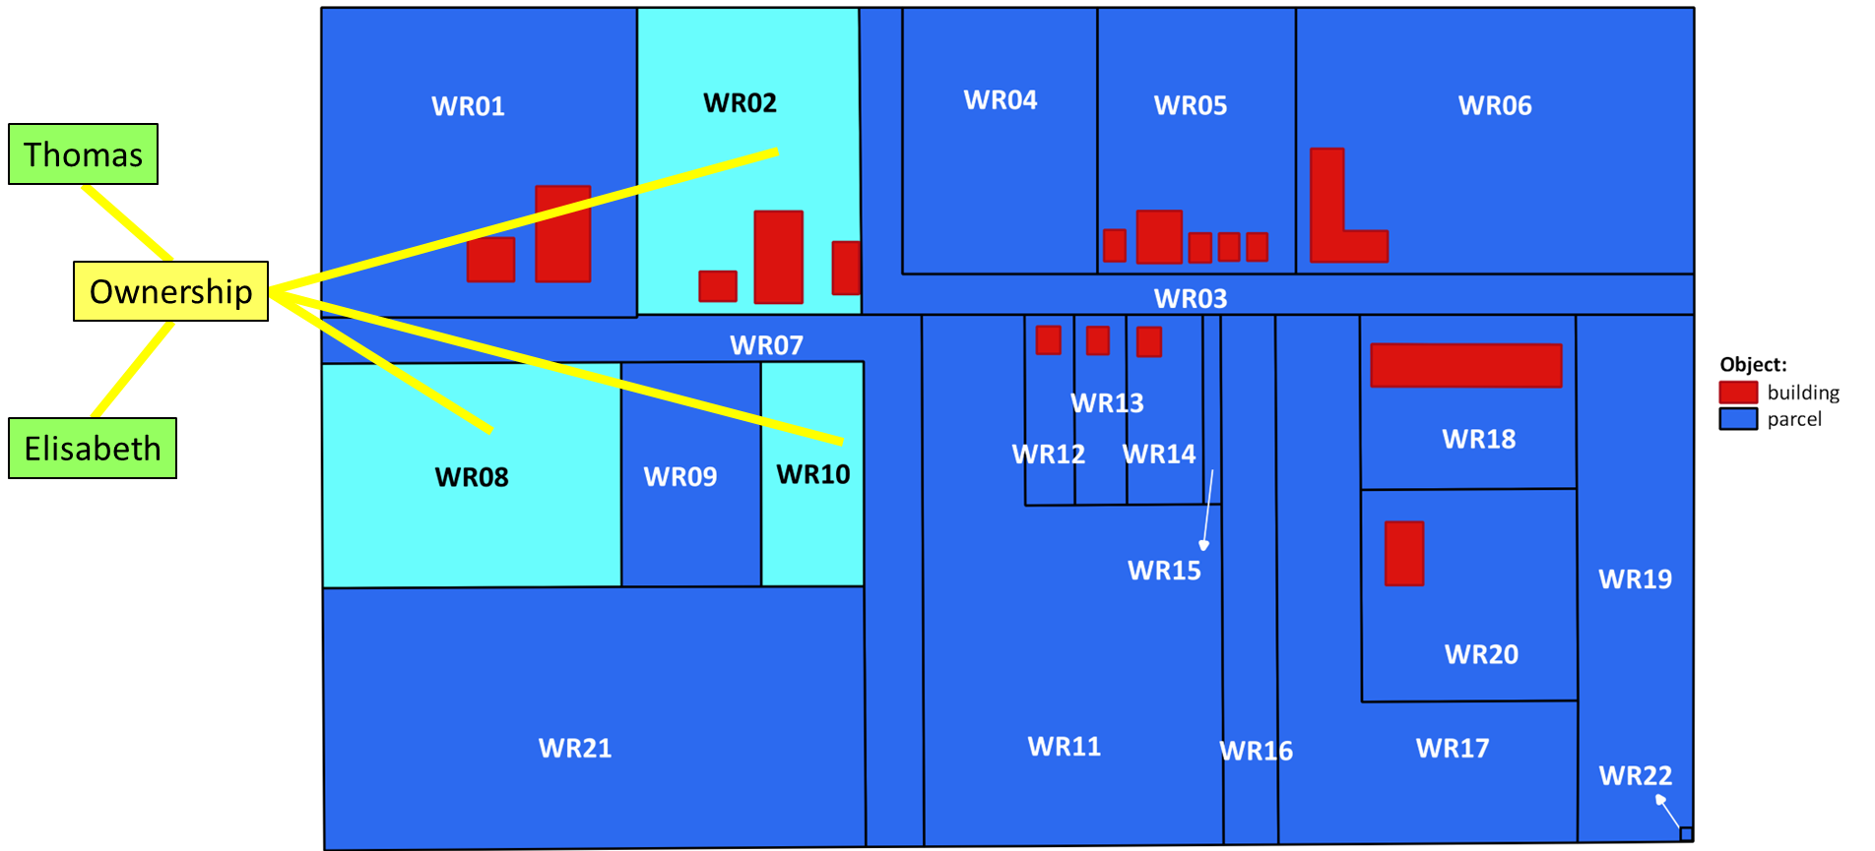
In LADM we say that Elisabeth and Thomas both have a share in the owership of BAU02
Tomas P02
½ Ownership Right02
WR02
BAU02
WR08
Elisabeth P03
½ Ownership Right02
WR10

Slide 17
BAU02 consists out of WR02, WR08, WR10
One property, three spatial units (parcels)
Tomas P02
½ Ownership Right02
WR02
BAU02
WR08
Elisabeth P03
½ Ownership Right02
WR10

Slide 18
p_id |  | name
1 | P01 | Carlos
2 | P02 | Thomas
3 | P03 | Elisabeth
4
5
6
7
8
9
10
11
12
13
14
15
16
17
18
r_id |  | type | share
1 | Right01 | Ownership
2 | Right02 | Ownership | 1/2
3 | Right02 | Ownership | 1/2
4
5
6
7
8
9
10
11
12
13
14
15
16
17
18
bau_id
1 | BAU01
2 | BAU02
3
4
5
6
7
8
9
10
11
12
13
14
15
16
17
18
su_id |  | area | geom | …
1 | WR01
2 | WR02
3 | …
4 | …
5 | …
6 | …
7 | …
8 | WR08
9 | …
10 | WR10
11
12
13
14
15
16
17
18

Slide 19
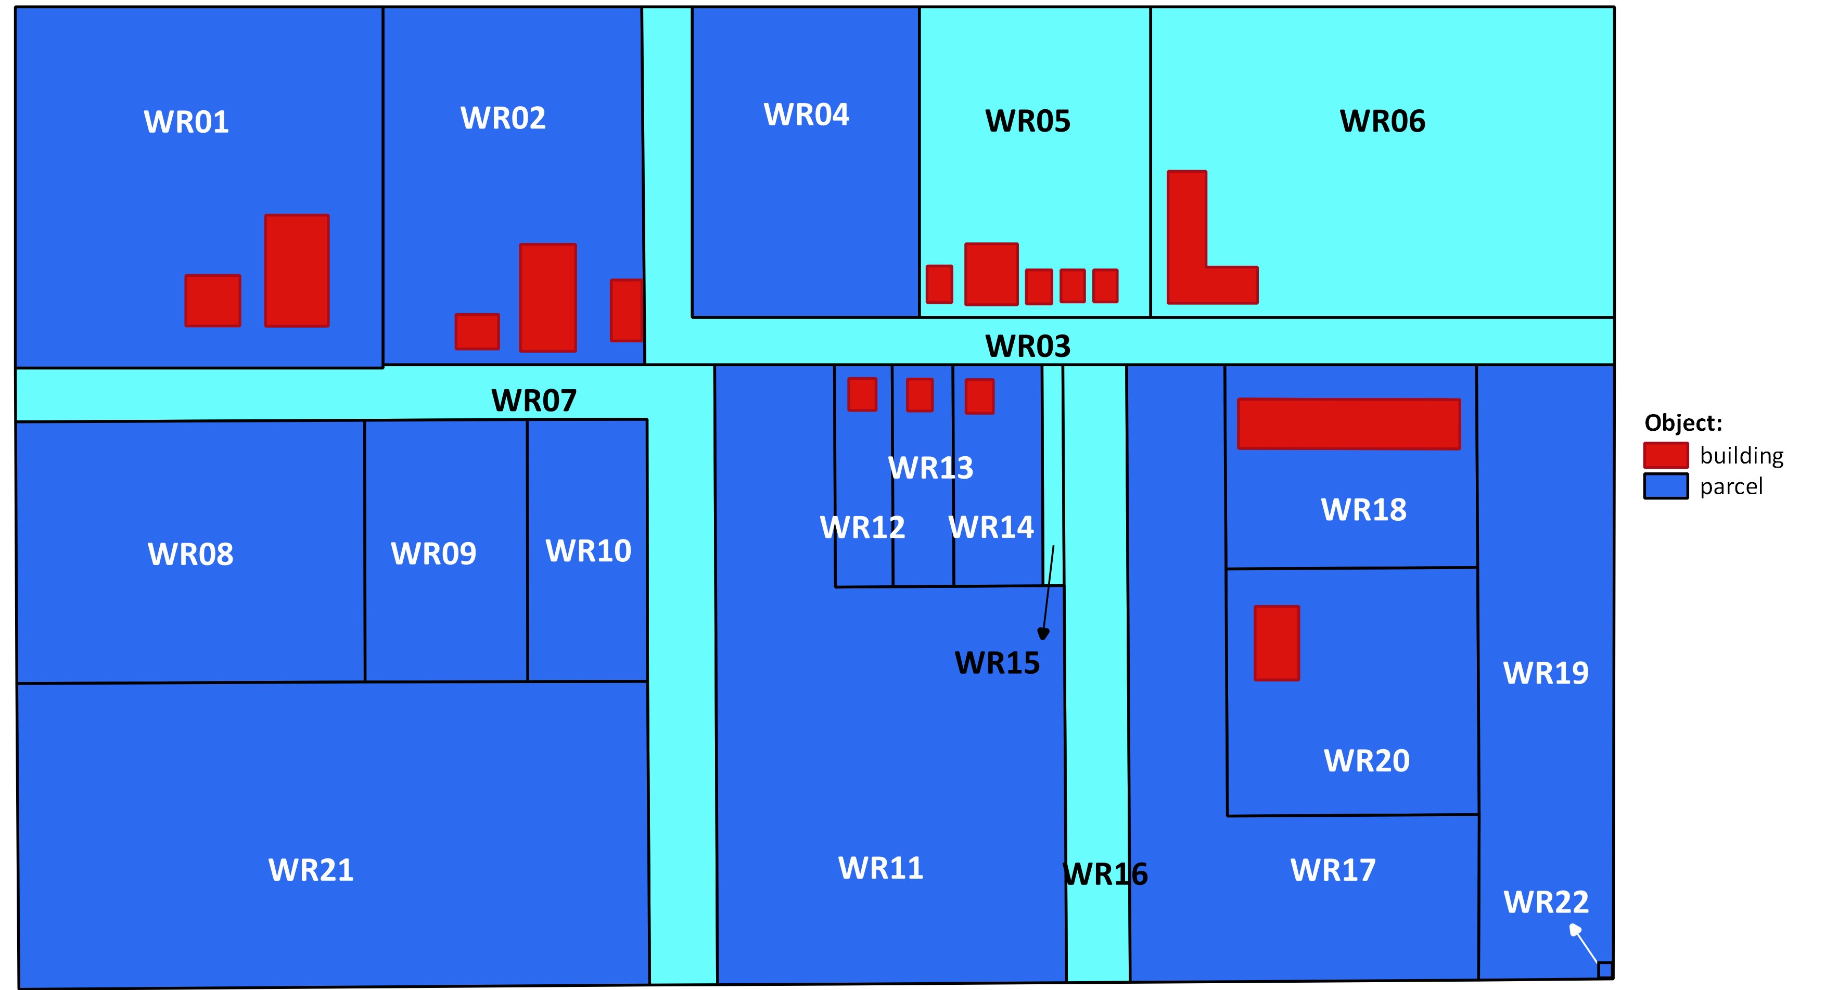
Municipality Waterriver
Ownership
Municipality Waterriver

Slide 20
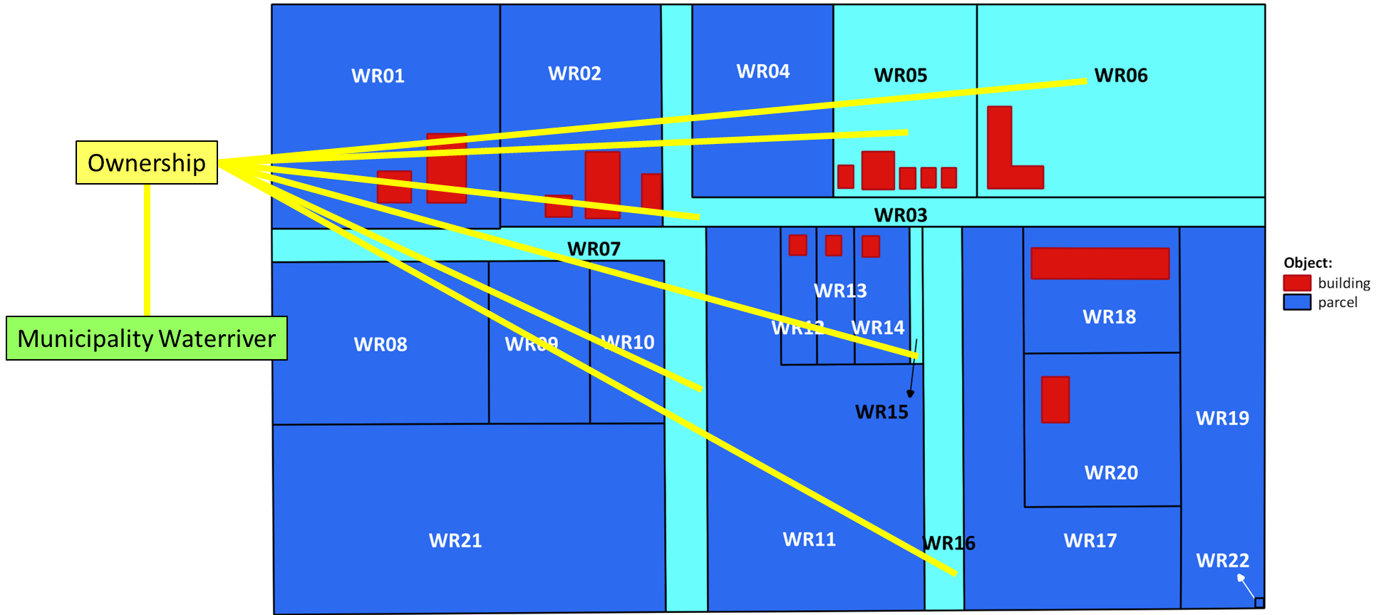
WR03
WR05
WR06
Municipality P04
Ownership Right03
BAU03
WR07
Municipality owns BAU03 consisting out of WR03, WR05, WR06, WR07, WR15 & WR16
WR15
WR16

Slide 21
p_id |  | name
1 | P01 | Carlos
2 | P02 | Thomas
3 | P03 | Elisabeth
4 | P04 | Municipality
5
6
7
8
9
10
11
12
13
14
15
16
17
18
r_id |  | type | share
1 | Right01 | Ownership
2 | Right02 | Ownership | 1/2
3 | Right02 | Ownership | 1/2
4 | Right03 | Ownership
5
6
7
8
9
10
11
12
13
14
15
16
17
18
bau_id
1 | BAU01
2 | BAU02
3 | BAU03
4
5
6
7
8
9
10
11
12
13
14
15
16
17
18
su_id |  | area | geom | …
1 | WR01
2 | WR02
3 | WR03
4 | …
5 | WR05
6 | WR06
7 | WR07
8 | WR08
9 | …
10 | WR10
11 | …
12 | …
13 | …
14 | …
15 | WR15
16 | WR16
17
18

Slide 22
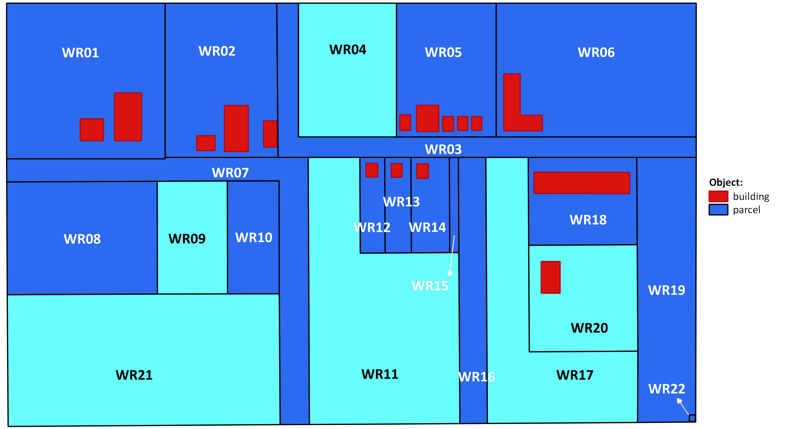
The Cooperation and Anna
Anna
Ownership
Ownership
Cooperation
Ownership
Ownership

Slide 23
Share in Rights or Shareholders
Anna P05
9/10 Ownership Right04
BAU04
WR04
Cooperation P06
1/10 Ownership Right04
Alternative: parties Anna and Cooperation as members of group party
Anna P05
9/10
Consortium Anna & Cooperation
Ownership Right04
BAU04
WR04
1/10
Cooperation P06
PartyMember is an associative class

Slide 24
Share in Rights
Anna P05
9/10 Ownership Right04
BAU04
WR04
Cooperation P06
1/10 Ownership Right04
9/10 Anna P05
Consortium Anna & Cooperation
Ownership Right04
BAU04
WR04
1/10 Cooperation P06

Slide 25
Shareholders
Anna P05
9/10 Ownership Right04
BAU04
WR04
Cooperation P06
1/10 Ownership Right04
PartyMemberAnna P05
9/10
GroupPart Consortium Anna & Cooperation
Ownership Right04
BAU04
WR04
1/10
PartyMember
Cooperation P06
PartyMember is an associative class

Slide 26
 | p_id | name
1 | P01 | Carlos
2 | P02 | Thomas
3 | P03 | Elisabeth
4 | P04 | Municipality
5 | P05 | Anna
6 | P06 | Cooperation
7
8
9
10
11
12
13
14
15
16
17
18
r_id |  | type | share
1 | Right01 | Ownership
2 | Right02 | Ownership | 1/2
3 | Right02 | Ownership | 1/2
4 | Right03 | Ownership
5 | Right04 | Ownership | 9/10
6 | Right04 | Ownership | 1/10
7
8
9
10
11
12
13
14
15
16
17
18
bau_id
1 | BAU01
2 | BAU02
3 | BAU03
4 | BAU04
5
6
7
8
9
10
11
12
13
14
15
16
17
18
su_id |  | area | geom | …
1 | WR01
2 | WR02
3 | WR03
4 | WR04
5 | WR05
6 | WR06
7 | WR07
8 | WR08
9 | …
10 | WR10
11 | …
12 | …
13 | …
14 | …
15 | WR15
16 | WR16
17
18

Slide 27
 | p_id | name
1 | P01 | Carlos
2 | P02 | Thomas
3 | P03 | Elisabeth
4 | P04 | Municipality
5 | P05 | Anna
6 | P06 | Cooperation
7
8
9
10
11
12
13
14
15
16
17
18
r_id |  | type | share
1 | Right01 | Ownership
2 | Right02 | Ownership | 1/2
3 | Right02 | Ownership | 1/2
4 | Right03 | Ownership
5 | Right04 | Ownership | 9/10
6 | Right04 | Ownership | 1/10
7
8
9
10
11
12
13
14
15
16
17
18
bau_id
1 | BAU01
2 | BAU02
3 | BAU03
4 | BAU04
5
6
7
8
9
10
11
12
13
14
15
16
17
18
su_id |  | area | geom | …
1 | WR01
2 | WR02
3 | WR03
4 | WR04
5 | WR05
6 | WR06
7 | WR07
8 | WR08
9 | …
10 | WR10
11 | …
12 | …
13 | …
14 | …
15 | WR15
16 | WR16
17
18

Slide 28
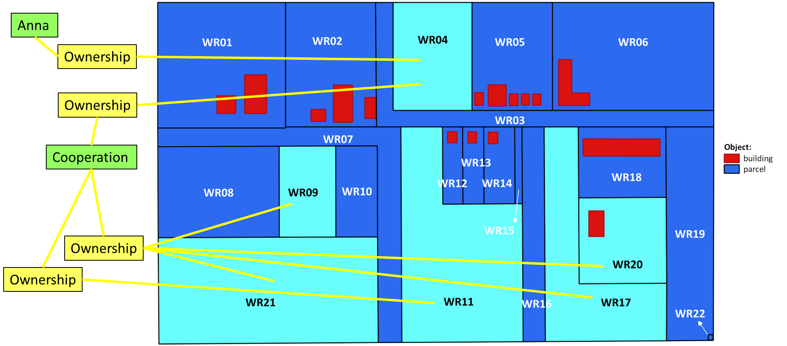
Anna has a share 9/10th in the ownership of BAU04
The Cooperation has a share 1/10th
The Cooperation further owns BAU05 and BAU06
Anna P05
9/10 Ownership Right04
WR04
BAU04
WR09
1/10 Ownership Right04
WR17
WR20
Cooperation P06
Ownership Right05
BAU05
WR21
Ownership Right06
BAU06
WR11

Slide 29
p_id |  | name
1 | P01 | Carlos
2 | P02 | Thomas
3 | P03 | Elisabeth
4 | P04 | Municipality
5 | P05 | Anna
6 | P06 | Cooperation
7
8
9
10
11
12
13
14
15
16
17
18
r_id |  | type | share
1 | Right01 | Ownership
2 | Right02 | Ownership | 1/2
3 | Right02 | Ownership | 1/2
4 | Right03 | Ownership
5 | Right04 | Ownership | 9/10
6 | Right04 | Ownership | 1/10
7 | Right05 | Ownership
8
9
10
11
12
13
14
15
16
17
18
bau_id
1 | BAU01
2 | BAU02
3 | BAU03
4 | BAU04
5 | BAU05
6
7
8
9
10
11
12
13
14
15
16
17
18
su_id |  | area | geom | …
1 | WR01
2 | WR02
3 | WR03
4 | WR04
5 | WR05
6 | WR06
7 | WR07
8 | WR08
9 | WR09
10 | WR10
… | …
… | …
17 | WR17
… | …
… | …
… | …
20 | WR20
21 | WR21

Slide 30
p_id |  | name
1 | P01 | Carlos
2 | P02 | Thomas
3 | P03 | Elisabeth
4 | P04 | Municipality
5 | P05 | Anna
6 | P06 | Cooperation
7
8
9
10
11
12
13
14
15
16
17
18
r_id |  | type | share
1 | Right01 | Ownership
2 | Right02 | Ownership | 1/2
3 | Right02 | Ownership | 1/2
4 | Right03 | Ownership
5 | Right04 | Ownership | 9/10
6 | Right04 | Ownership | 1/10
7 | Right05 | Ownership
8 | Right06 | Ownership
9
10
11
12
13
14
15
16
17
18
bau_id
1 | BAU01
2 | BAU02
3 | BAU03
4 | BAU04
5 | BAU05
6 | BAU06
7
8
9
10
11
12
13
14
15
16
17
18
su_id |  | area | geom | …
1 | WR01
2 | WR02
3 | WR03
4 | WR04
5 | WR05
6 | WR06
7 | WR07
8 | WR08
9 | WR09
10 | WR10
11 | WR11
… | …
17 | WR17
… | …
… | …
… | …
20 | WR20
21 | WR21

Slide 31
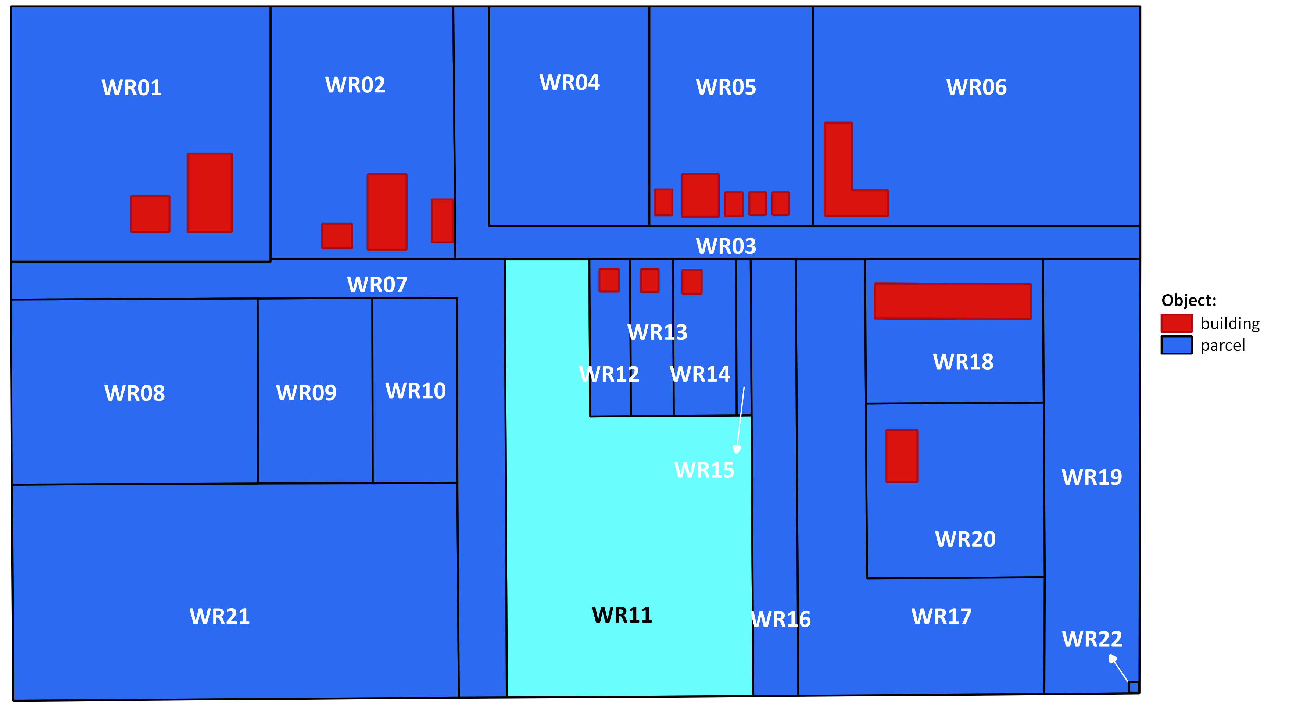
There is a Mortgage (restriction), a Usufruct and Ownership on BAU06 whith Spatial Unit WR11
Usufruct
Municipality
Capital Bank
Mortgage
Ownership
Cooperation

Slide 32
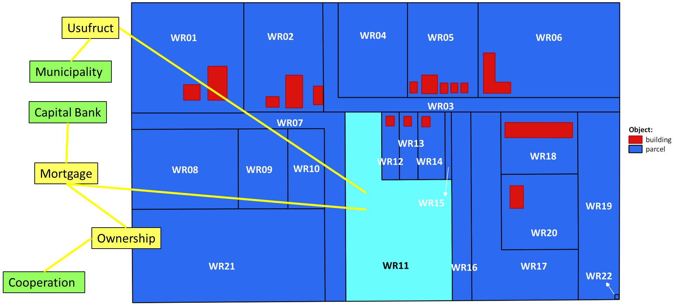
Cooperation has a Mortgage on BAU06 and
Municipality a usufruct
Cooperation P06
Ownership Right06
Capital Bank P07
Mortgage Restriction01
BAU06
WR11
Municipality P04
Usufruct Right07

Slide 33
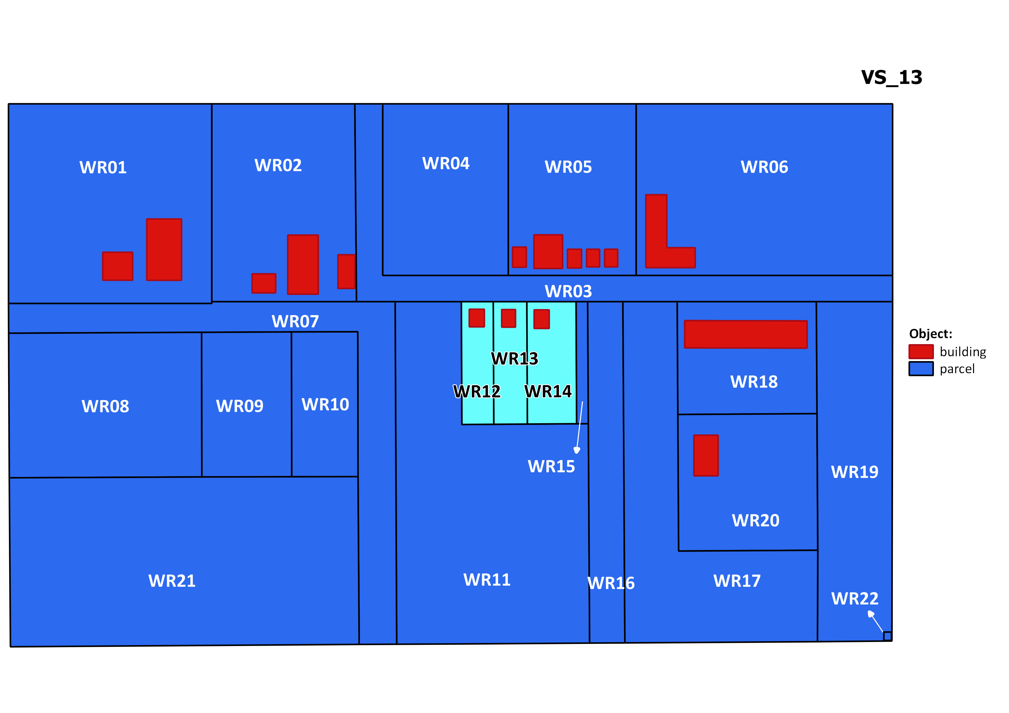
Housing Company
Housing Company
Ownership
Ownership
Ownership

Slide 34
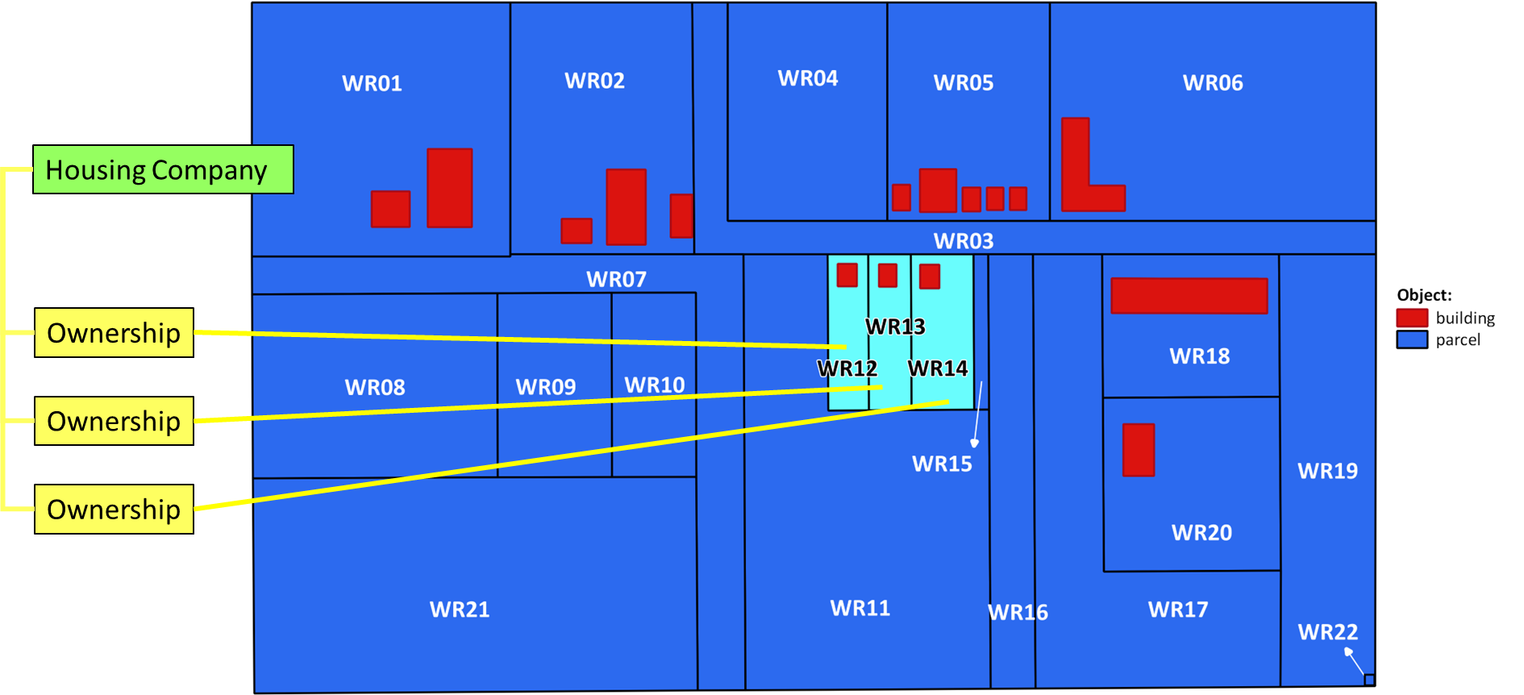
Ownership Right08
BAU07
WR12
Housing
Company P08
Ownership Right09
BAU08
WR13
Ownership Right10
BAU09
WR14

Slide 35
 | p_id | name
1 | P01 | Carlos
2 | P02 | Thomas
3 | P03 | Elisabeth
4 | P04 | Municipality
5 | P05 | Anna
6 | P06 | Cooperation
7 | P07 | Capital Bank
8 | P08 | Housing Company
9
10
11
12
13
14
15
16
17
18
 | r_id | type | share
1 | Right01 | Ownership
2 | Right02 | Ownership | 1/2
3 | Right02 | Ownership | 1/2
4 | Right03 | Ownership
5 | Right04 | Ownership | 9/10
6 | Right04 | Ownership | 1/10
7 | Right05 | Ownership
8 | Right06 | Ownership
9 | Right07 | Usufruct
10 | Right08 | Ownership
11 | Right09 | Ownership
12 | Right10 | Ownership
13 | …
14 | …
15 | …
16 | …
17 | Restr01 | Mortgage
18
 | bau_id
1 | BAU01
2 | BAU02
3 | BAU03
4 | BAU04
5 | BAU05
6 | BAU06
7 | BAU07
8 | BAU08
9 | BAU09
10
11
12
13
14
15
16
17
18
 | su_id | area | geom | …
1 | WR01
2 | WR02
3 | WR03
4 | WR04
5 | WR05
6 | WR06
7 | WR07
8 | WR08
9 | WR09
10 | WR10
11 | WR11
12 | WR12
13 | WR13
14 | WR14
… | …
… | …
… | …
21 | WR21

Slide 36
Housing Company and its LongLeaseholders
Maria and Johan
LongLease
Anton
LongLease
LongLease
James

Slide 37
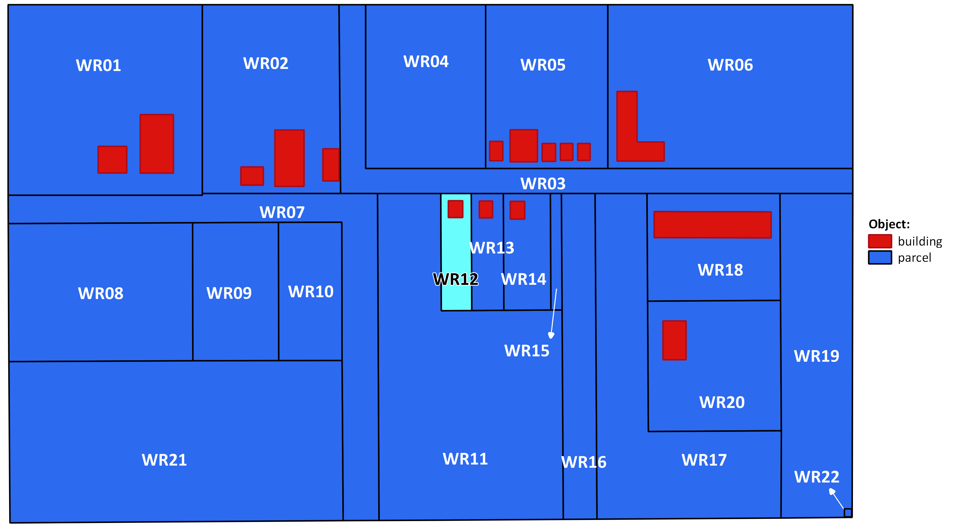
Housing Company and Maria and Johan
Housing Company
Ownership
LongLease
Maria and Johan

Slide 38
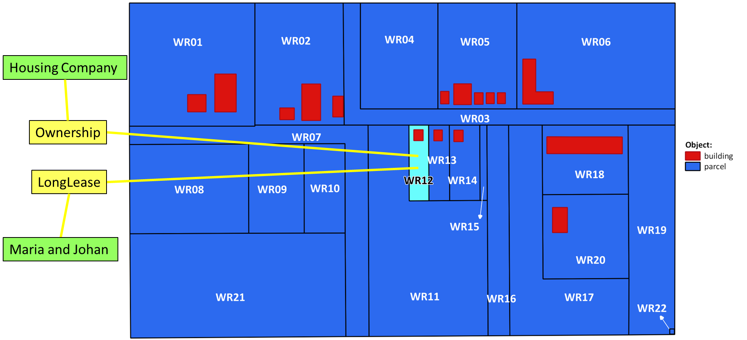
Housing Company and Maria and Johan
Housing
Company P08
Ownership Right08
Maria P09
½ LongLease Right11
BAU07
WR12
Johan P10
½ LongLease Right11

Slide 39

Housing Company and Anton
Housing Company
Ownership
LongLease
Anton

Slide 40
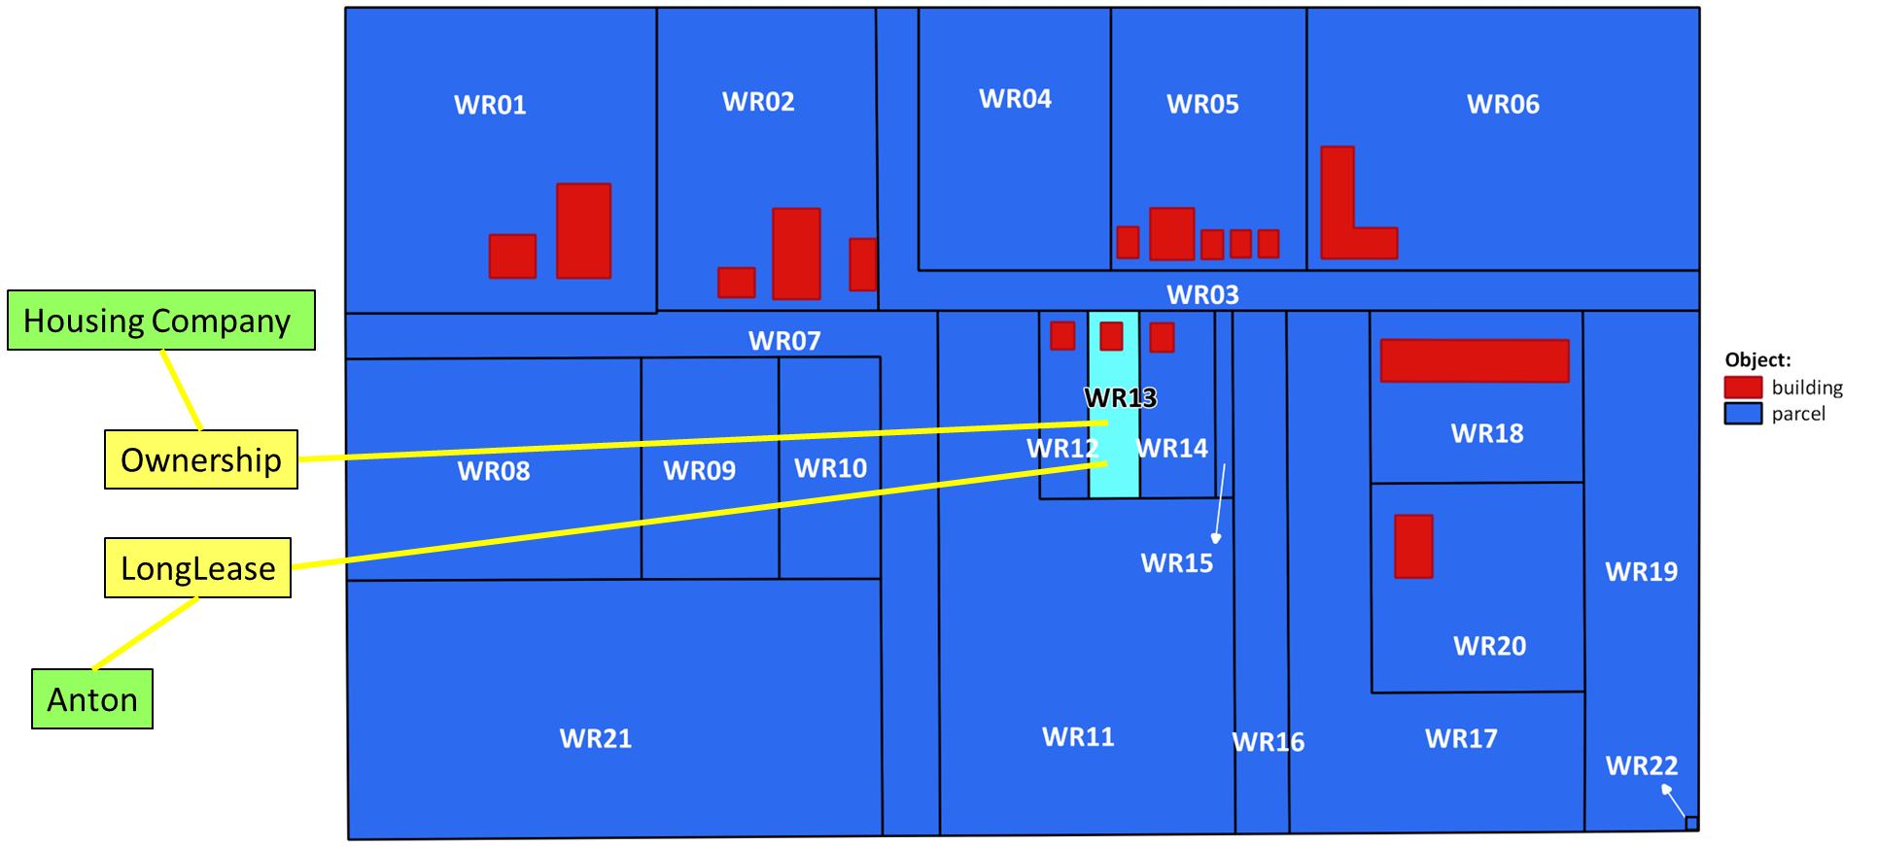
Housing Company and Anton
Housing
Company P08
Ownership Right09
BAU08
WR13
Anton P11
Leasehold Right12

Slide 41
There is a Mortgage on Anton’s LongLease
Housing Company
Ownership
Anton
LongLease
Capital Bank
Mortgage

Slide 42
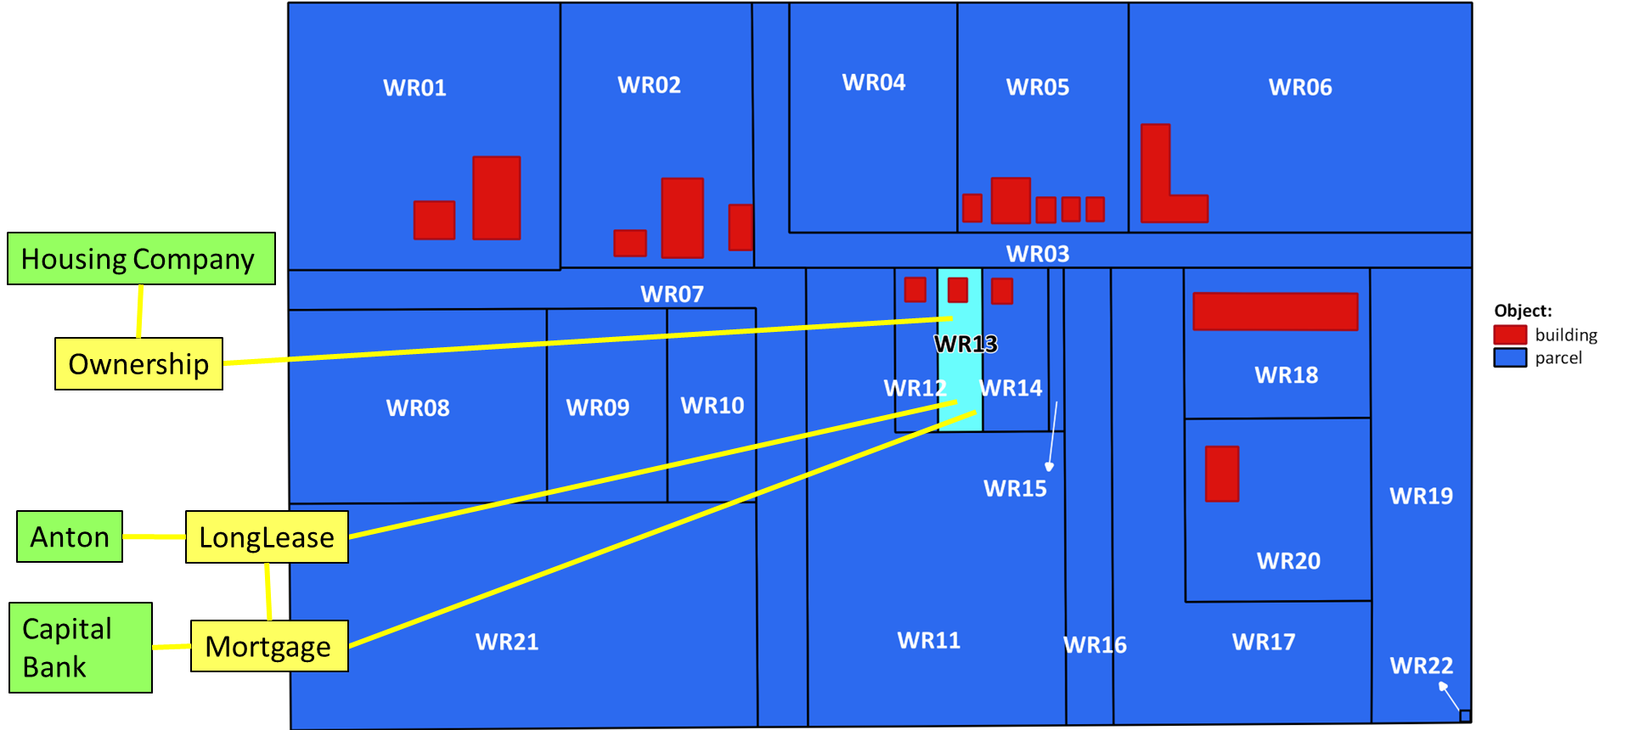
There is a Mortgage on Anton’s Leasehold
Housing
Company P08
Ownership Right09
Anton P11
Leasehold Right12
BAU08
WR13
Capital Bank P07
Mortgage Restriction02

Slide 43
Capital Bank
Mortgage Restriction01
BAU06
WR11
Capital Bank P07
Mortgage Restriction02
BAU08
WR13

Slide 44
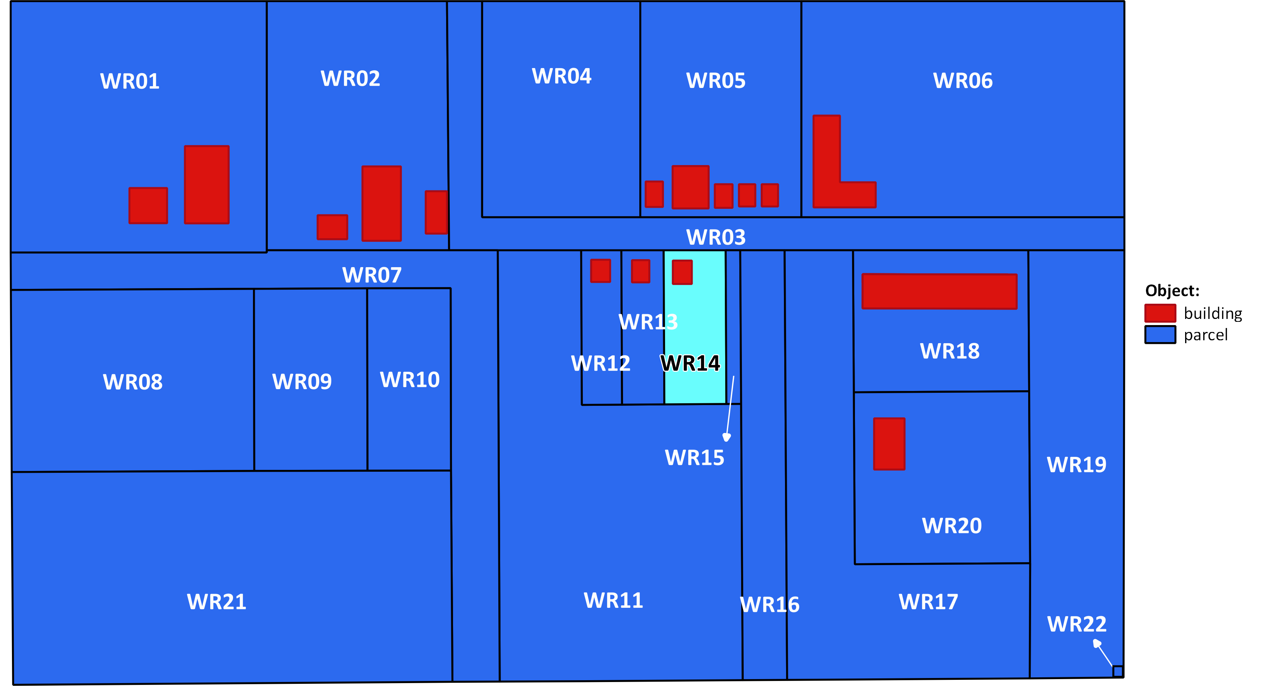
Housing Company and James
Housing Company
Ownership
Lease
James

Slide 45
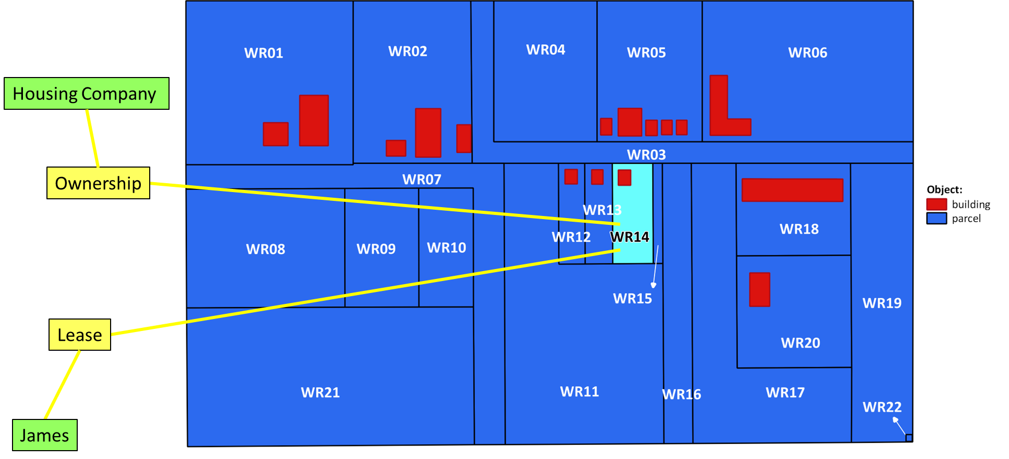
Housing Company and James
Housing Company P08
Ownership Right10
BAU09
WR14
James P12
Leasehold Right13

Slide 46
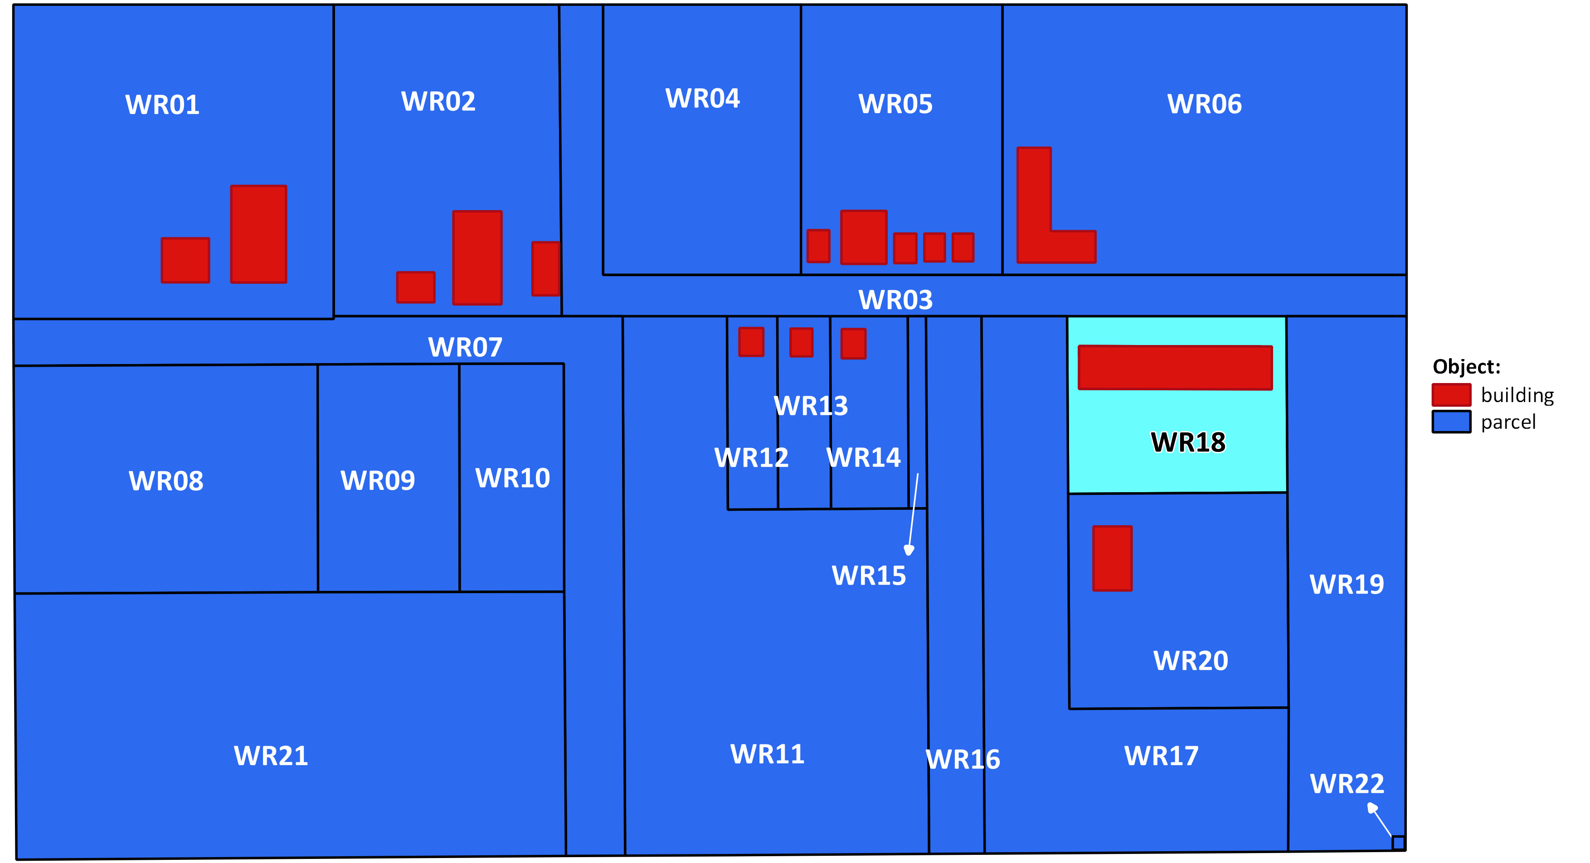
Association of Owners
Association of Owners
Ownership

Slide 47
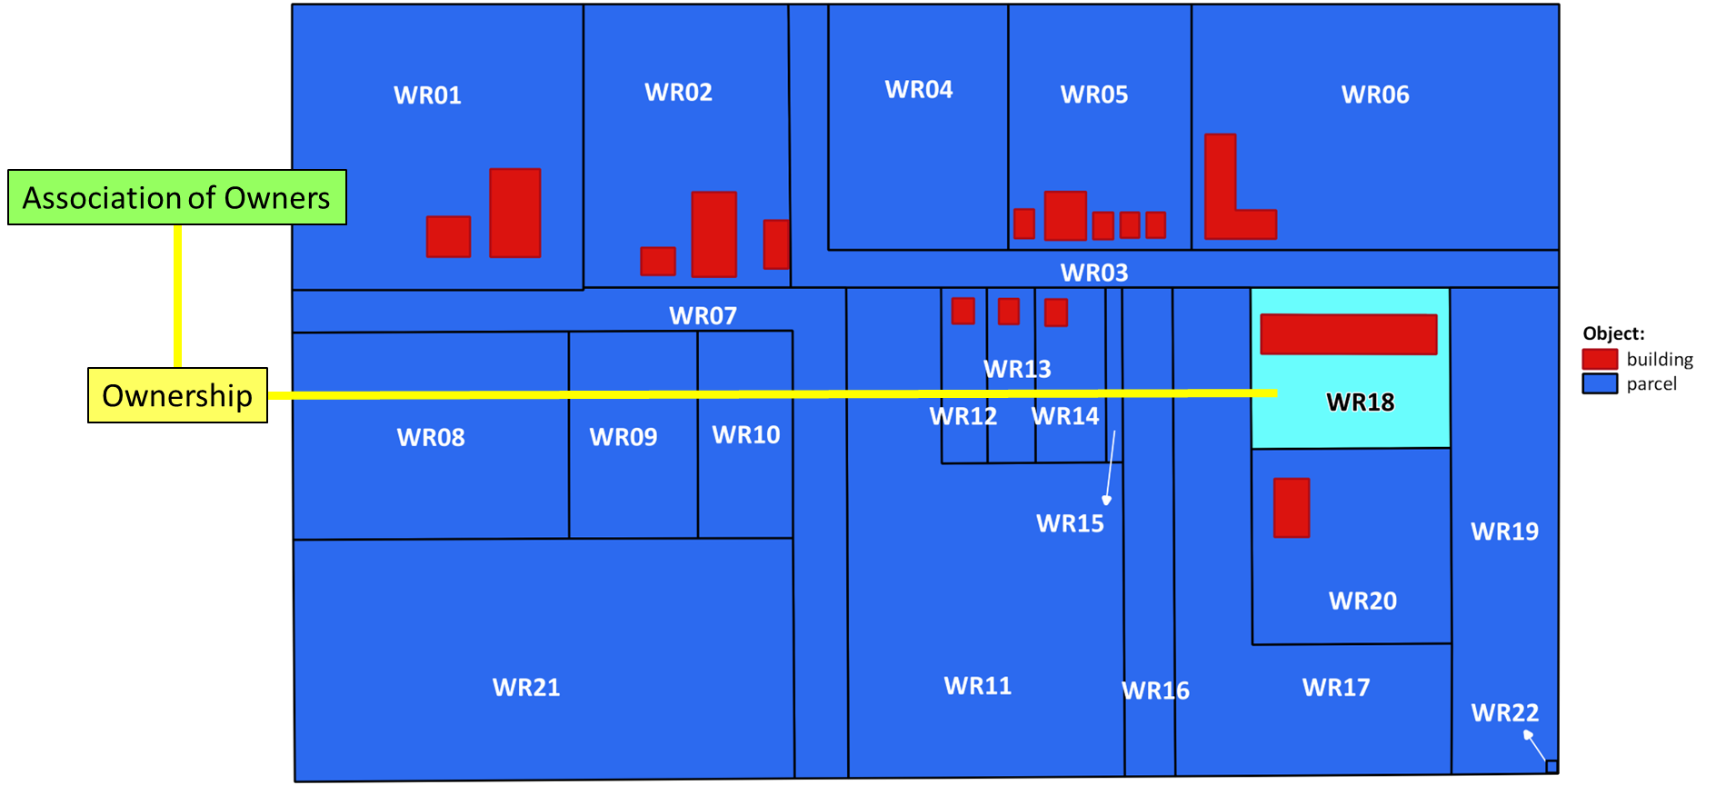
Association of Owners
Association of Owners P13
Ownership Right14
BAU10
WR18

